Slide 1



Healthy Animals, Healthy People

Slide 2
What Are We Going to Learn About?
What is One Health?
What are zoonotic diseases?
How do zoonotic diseases spread?
What are the signs and symptoms in animals?
What are the signs and symptoms in people?
How can zoonotic diseases be prevented?
What is biosecurity?

Slide 3
What Is One Health?
The concept that animal health, human health, and environmental health are all connected.

Slide 4
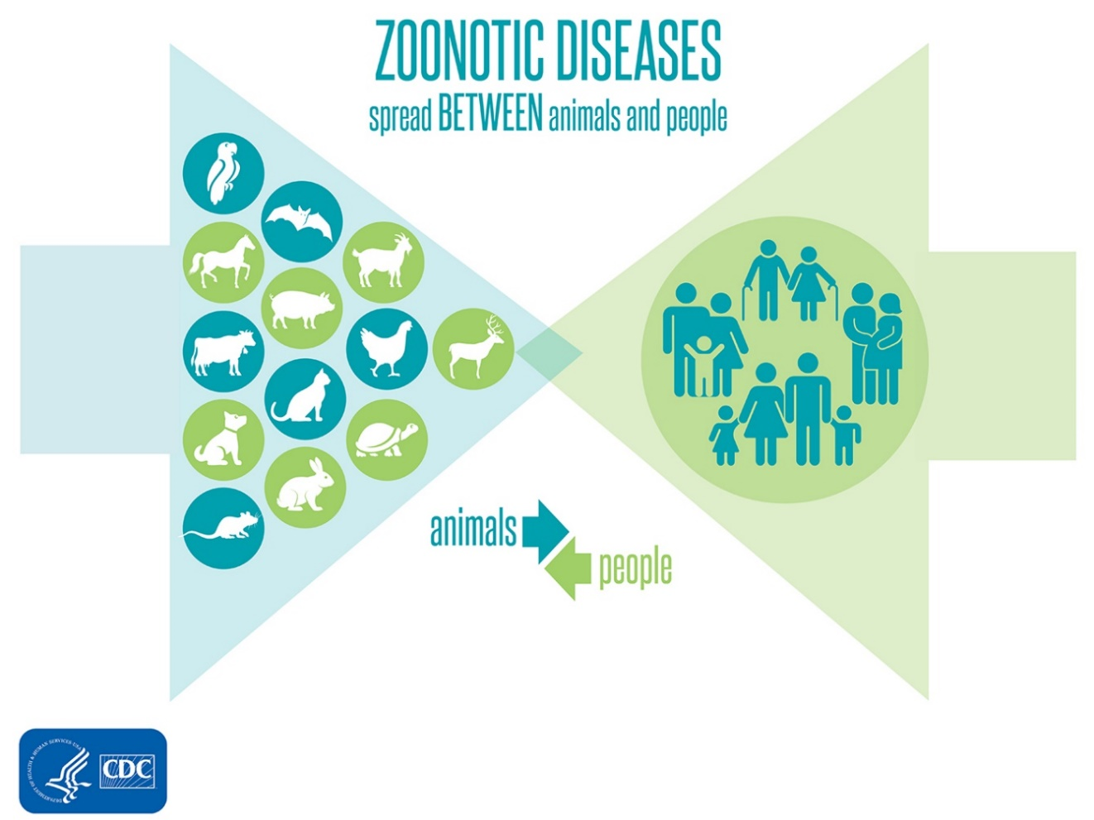
What Are Zoonotic Diseases?
Scientists estimate that more than 6 in every 10 known infectious diseases in people are spread from animals

Slide 5
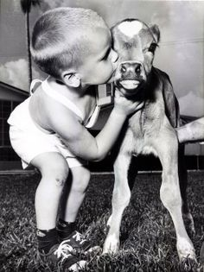
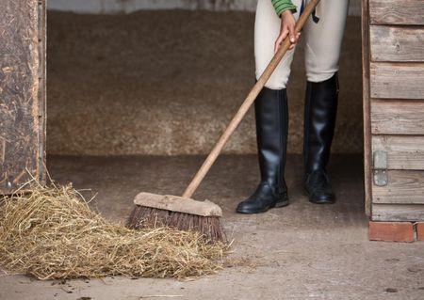
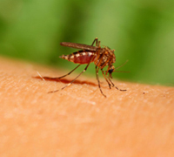
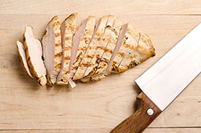
How Do Zoonotic Diseases Spread?
Photo courtesy of thesrpucepets.com
Photo courtesy of vintag.es
Indirect Contact
Direct Contact
Photo courtesy of CDC
Photo courtesy of CDC
Vectorborne
Foodborne

Slide 6
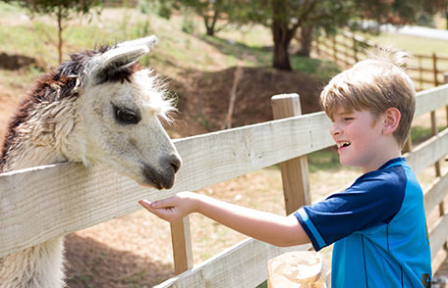
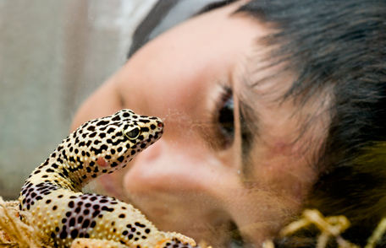
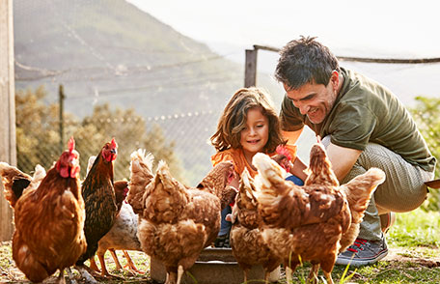
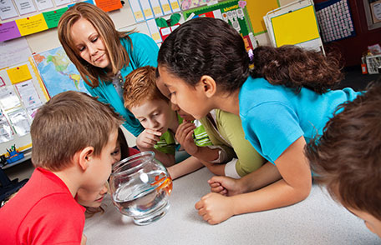
Why Do Zoonotic Diseases Matter?
People can come into contact with animals in many places.
Anyone can become sick from a zoonotic disease, including healthy people and healthy animals.
Photos courtesy of CDC

Slide 7



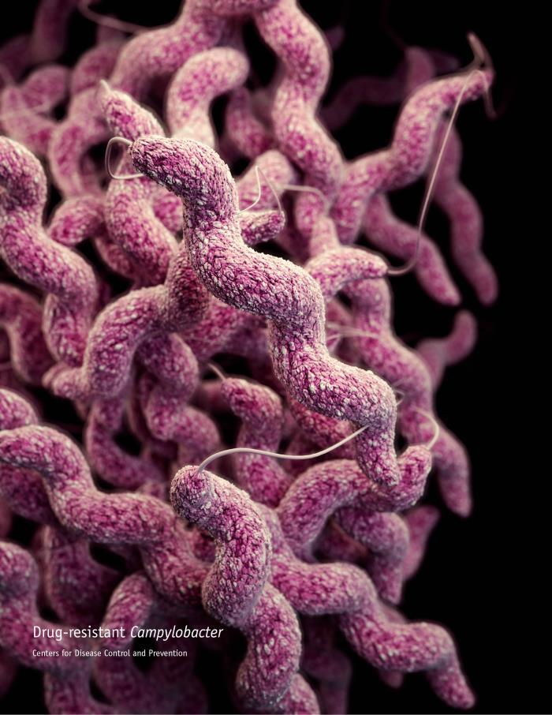
Enteric Zoonotic Diseases:
Campylobacteriosis
Caused by Campylobacter bacteria
aka “Campy”
Common hosts: cattle, poultry, pigs
What to avoid: Undercooked food, contaminated water, raw milk, manure
Photo courtesy of CDC

Slide 8

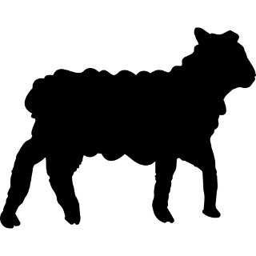
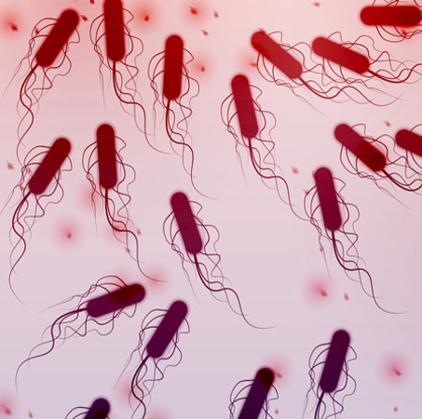
Enteric Zoonotic Diseases:
E. coli infection
Caused by Escherichia coli (E. coli) bacteria
Some can be Shiga-toxin producing E. coli (STEC) and can cause severe disease
Common hosts: cattle, goats, sheep
What to avoid: Undercooked food, contaminated water, raw milk, manure
Photo courtesy of CDC

Slide 9

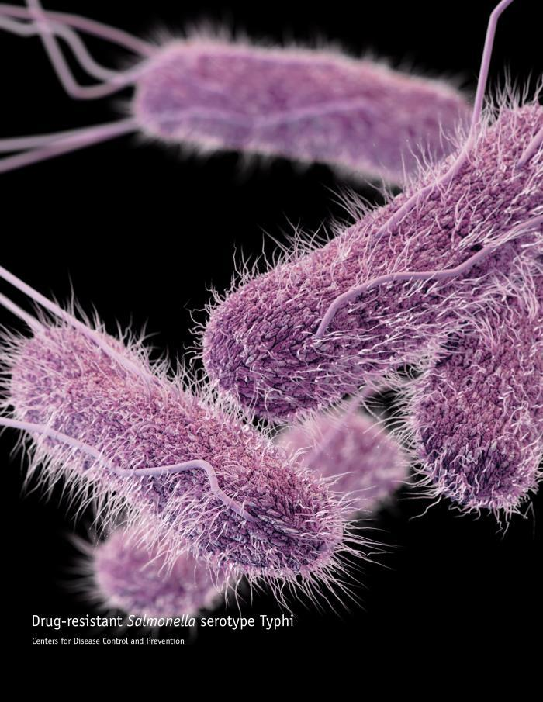


Enteric Zoonotic Diseases:
Salmonellosis
Caused by Salmonella bacteria
Common hosts: cattle, chickens, reptiles, amphibians
What to avoid: Contaminated food, manure, touching reptiles
Photo courtesy of CDC

Slide 10
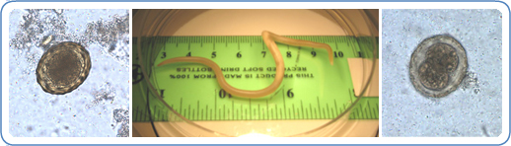
Enteric Zoonotic Diseases:
Ascariasis
Caused by Ascaris lumbricoides (roundworm) parasite
Common hosts: pigs
Photo courtesy of CDC
What to avoid: Contaminated vegetables/ fruit, manure

Slide 11

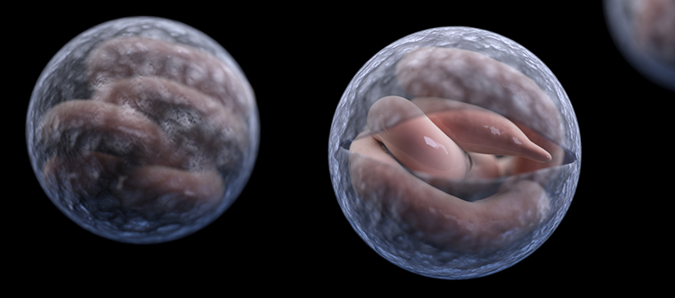
Enteric Zoonotic Diseases:
Cryptosporidiosis
Caused by Cryptosporidium parasite
aka “Crypto”
Common hosts: Cattle
What to avoid: Contaminated food, contaminated water, raw milk, manure (especially from sick calves)
Photo courtesy of CDC

Slide 12
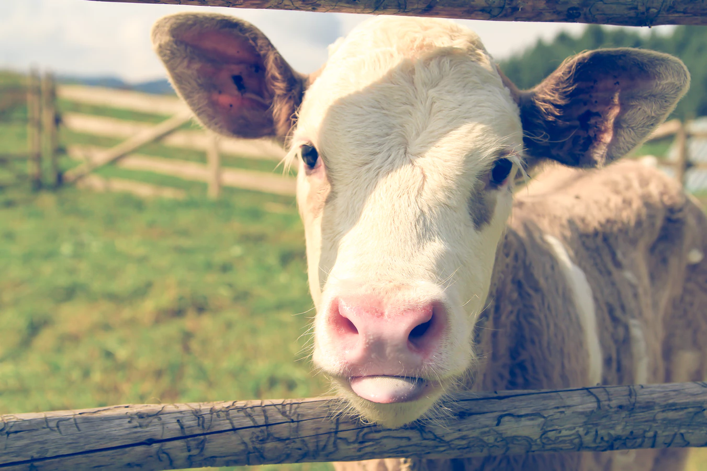
Signs In Animals
Animals often appear healthy
Diarrhea (especially in young animals)
Photo courtesy of CDC

Slide 13
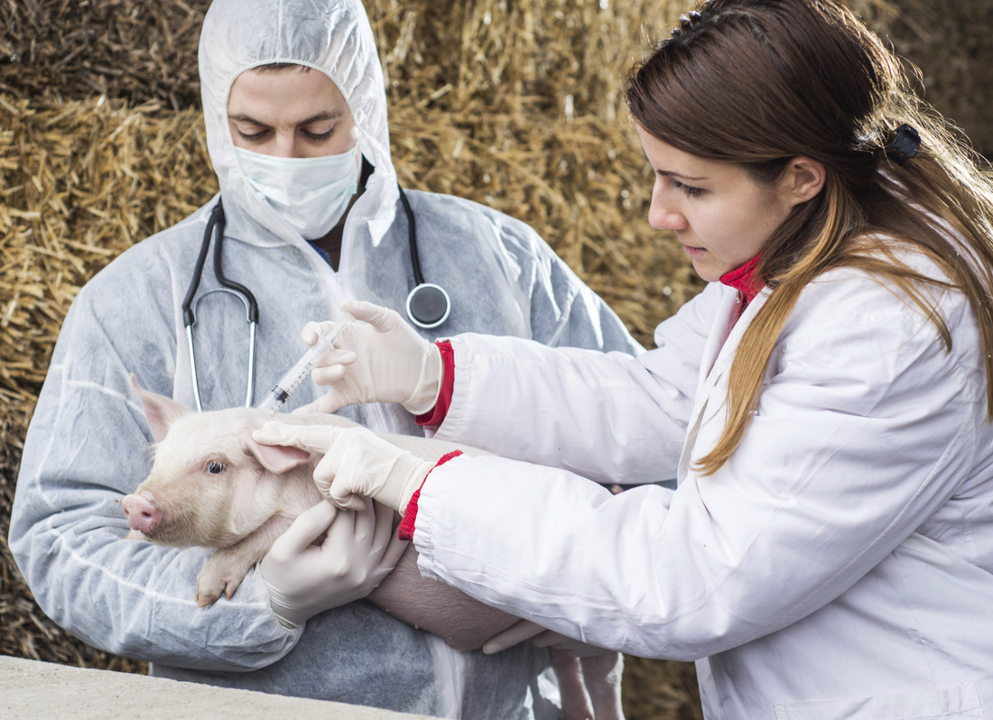
How Can I Prevent These Diseases?
... in Animals
Keep environment clean
Avoid sharing equipment/allowing contact with other herds
Regular deworming for parasites
Routine veterinary care for herd health
Photo courtesy of globalnews.ca
Notes:
Image source: globalnews.com

Slide 14
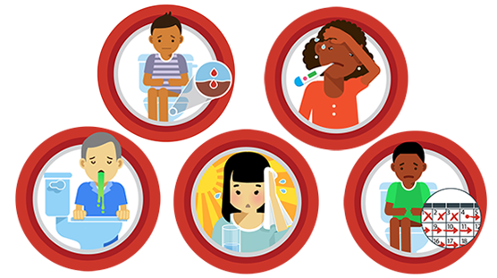
Signs And Symptoms In Humans
Diarrhea
Vomiting
Fever
Nausea
Dehydration
Stomach pain
Image courtesy of CDC

Slide 15
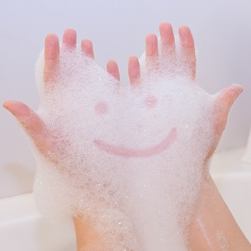
How Can I Prevent These Diseases?
… in Humans
Always wash hands
  after handling animals, their manure, bedding, etc.
  before eating
  after handling raw meat.
Always wash produce
Cook food thoroughly
Do not drink raw milk
Photo courtesy of Lippincott NursingCenter

Slide 16
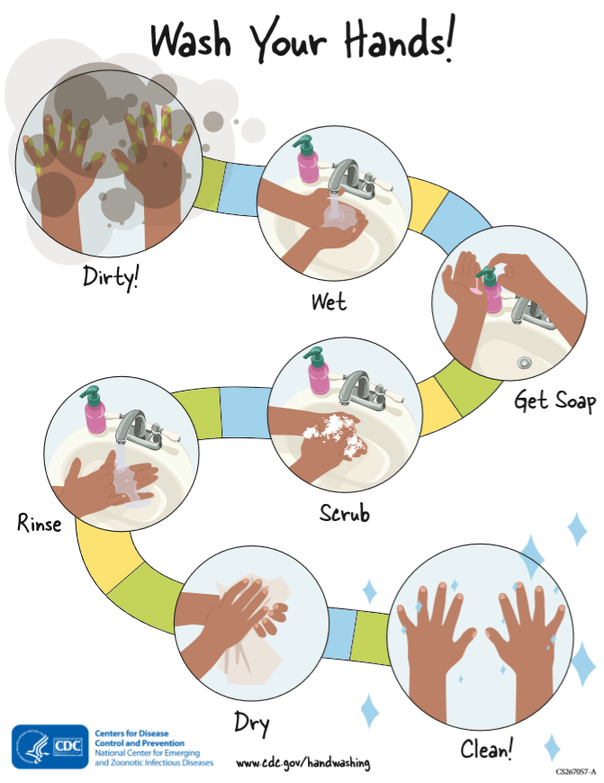
How Should I Wash My Hands?
Wet your hands with clean, running water and apply soap.
Lather your hands by rubbing them together with the soap.
Scrub your hands for at least
20 seconds.
Rinse your hands well under clean, running water.
Dry your hands using a clean towel or air dry them.

Slide 17
Why Have I Not Gotten Sick?
How many times have you had diarrhea and not known why?
  Signs and symptoms are often overlooked in healthy people (less likely to experience severe symptoms)
  People who spend a lot of time around animals can develop immunity to some diseases

Slide 18
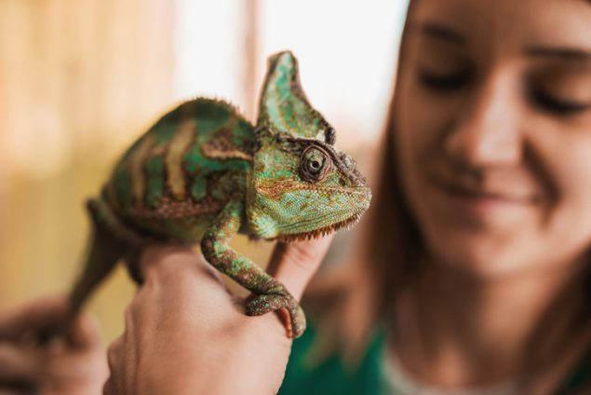
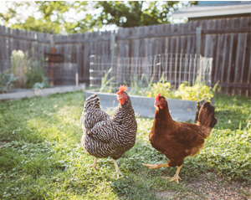
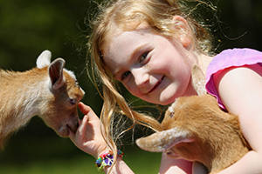
Questions?
Photos courtesy of CDC

Slide 19

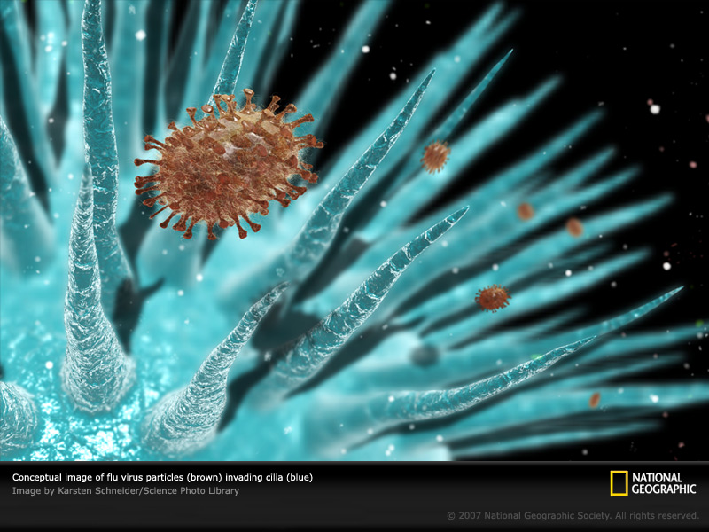
What Is Influenza?
Caused by influenza virus
aka “the flu”
Common hosts: humans, pigs, birds
What to avoid: Direct and indirect contact with infected animals and people

Slide 20
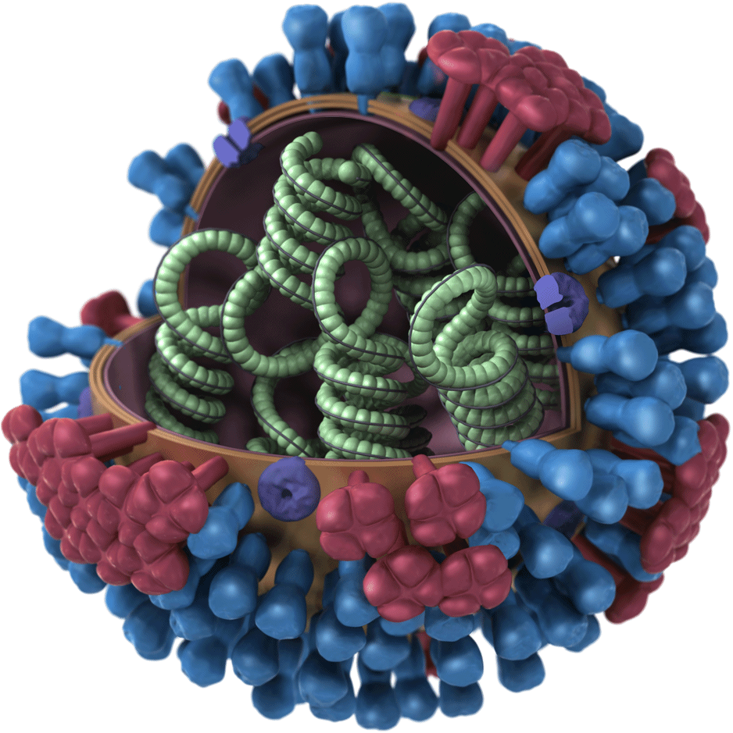
Why Is Influenza Concerning?
Influenza can be serious and even deadly in humans and animals
The influenza virus changes often (mutates)
  Hard to prevent
  Can get more than once
Influenza in one species can change and infect another species
Image courtesy of CDC

Slide 21

How Does Influenza Mutate?
Avian virus
Avian virus
human virus
Swine virus
New influenza virus

Slide 22
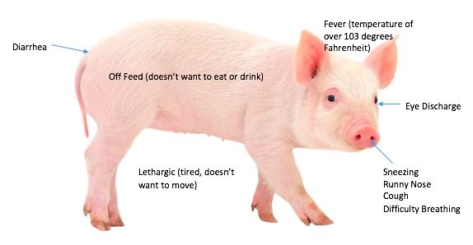
Signs Of Influenza In Pigs
Image courtesy of Strange History

Slide 23
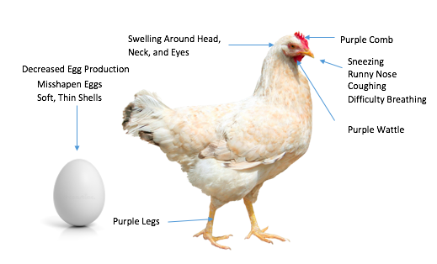
Signs Of Influenza In Poultry
Swelling Around Head, Neck, and Eyes
Purple Comb
Decreased Egg Production
Sneezing
Runny Nose
Coughing
Difficult Breathing
Misshapen Eggs
Soft, Thin Shells
Purple Wattle
Purple Legs
Sudden increase in flock deaths
Images courtesy of Kindersay.com and dreamstime.com

Slide 24
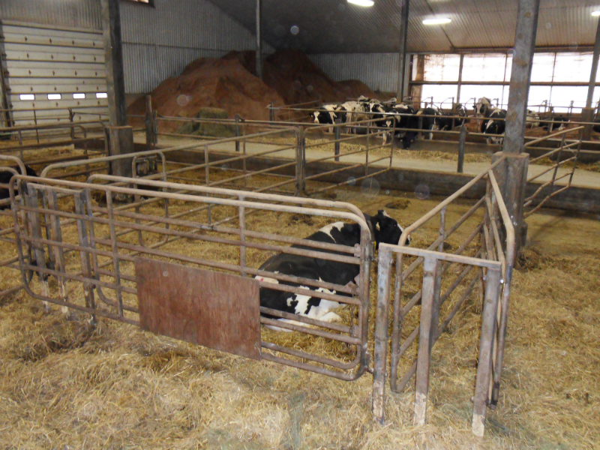
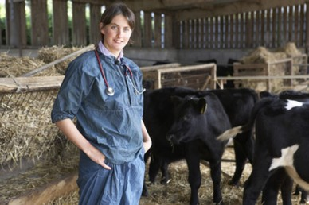
What Do I Do If My Animal Is Sick?
Quarantine (Isolation)- Keep sick animal away from other animals and people
Photo courtesy of Biosecurity Nova Scotia
Call your veterinarian
Photo courtesy of Pocket Farm

Slide 25
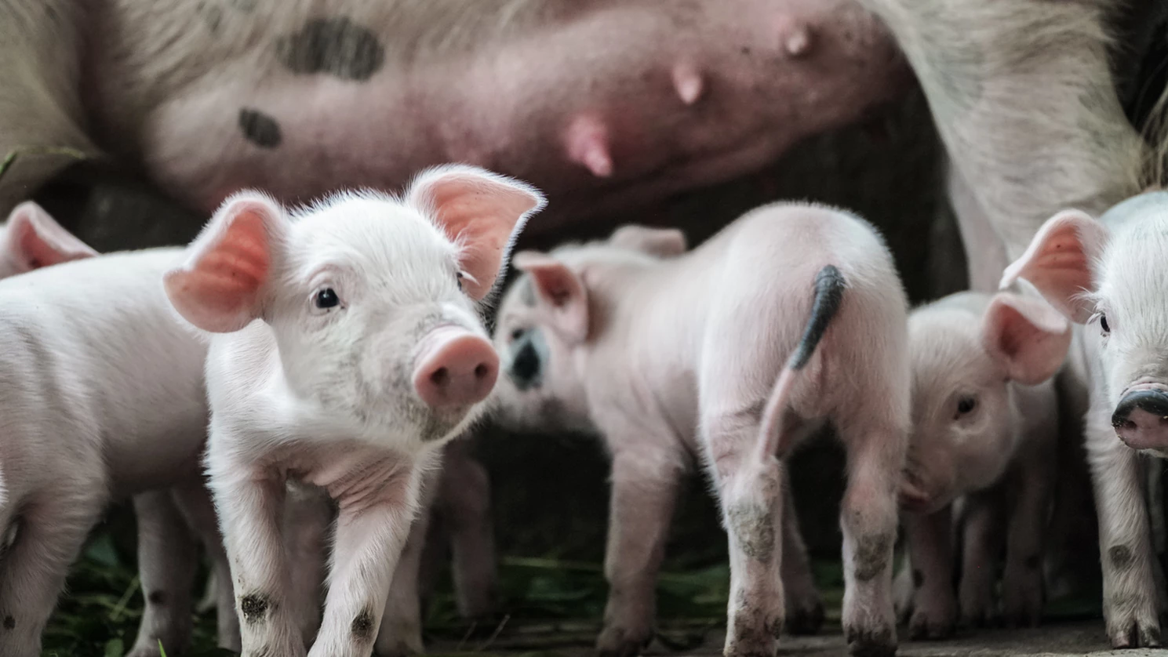
How Can I Prevent Influenza?
… in Animals
Keep area clean
Avoid contact with sick animals or sick people
Talk to a veterinarian
Photo courtesy of Unsplash

Slide 26
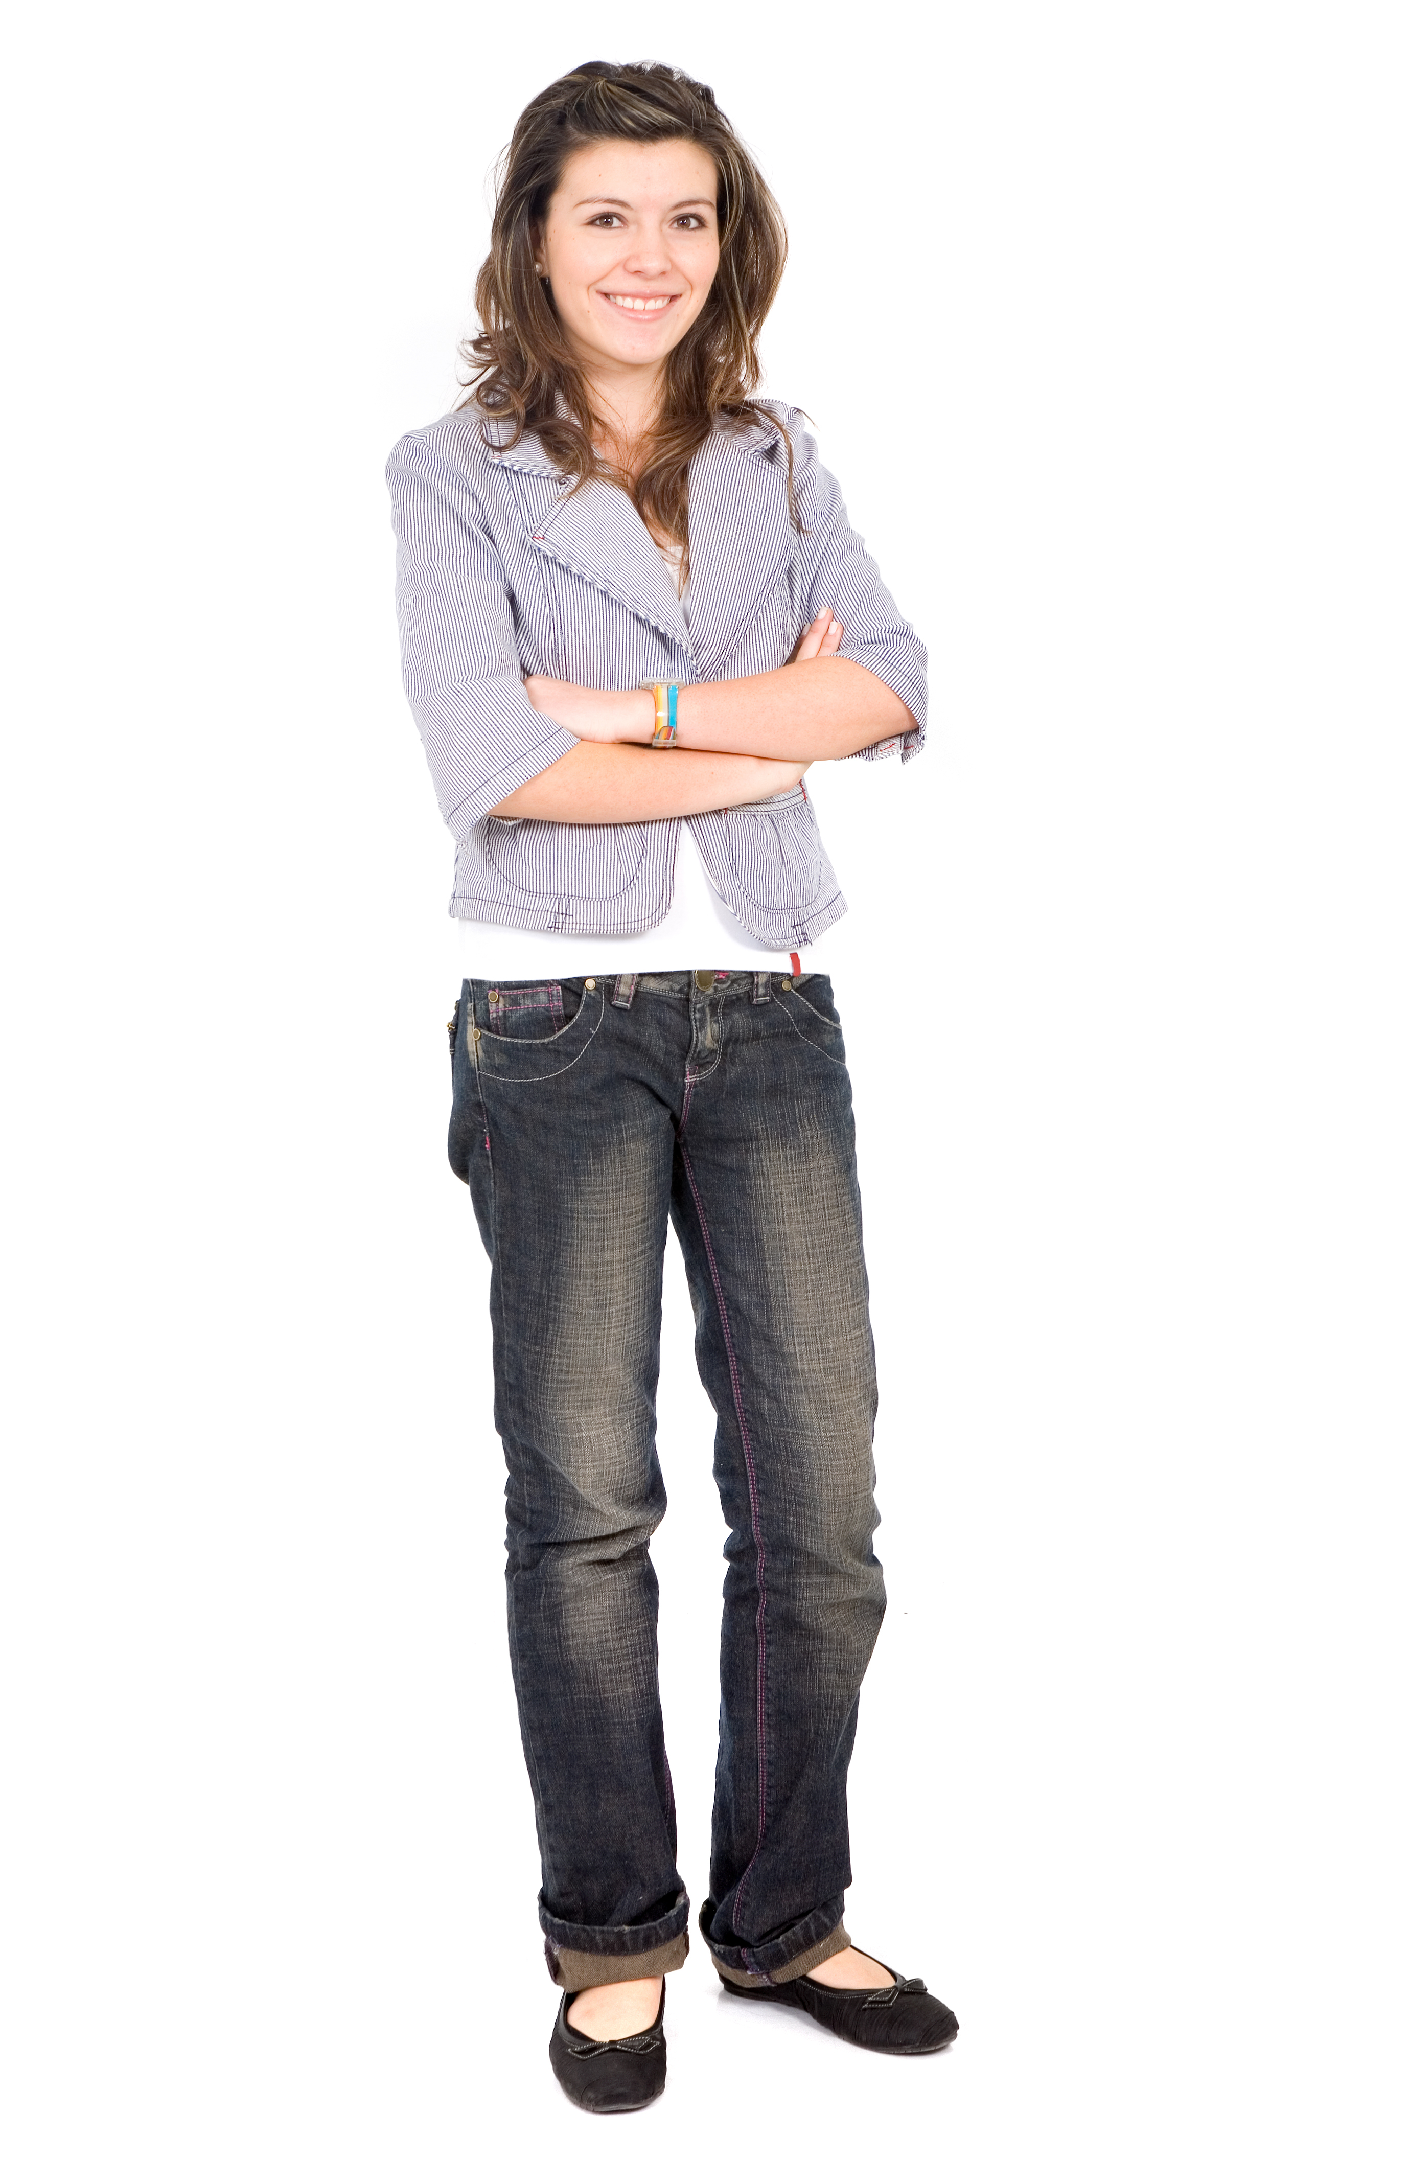
Signs And Symptoms Of Influenza In Humans
Fever of 100°F or higher
Headaches
Runny/stuffy nose
Cough
Sore throat
Muscle/body aches
Fatigue (tiredness)
Images courtesy of Shutterstock

Slide 27
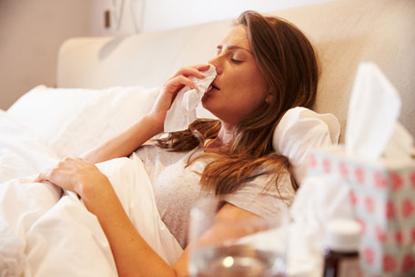
What Do I Do If I Am Sick?
Cover your cough and sneeze
Stay at home
Minimize contact with animals and other people
Call your healthcare provider
  SPECIAL NOTE: Tell your healthcare provider if you have recently been around pigs or chickens.
Photo courtesy of CDC

Slide 28
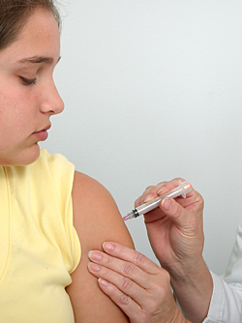
How Can I Prevent Influenza?
…in Humans
Wash hands frequently
Cover your cough
Stay at home when sick
Vaccinate
  Annual seasonal vaccine for humans
Avoid contact with sick people and sick animals
Photo courtesy of CDC

Slide 29
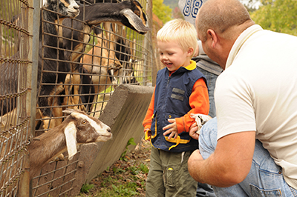
Who Else Is At Risk For Getting Sick?
Visitors and the public!
  These diseases can be severe or even deadly for young children and anyone with a weakened immune system
  The goals is to keep ourselves, our animals, and people visiting our animals safe
Photo courtesy of CDC

Slide 30
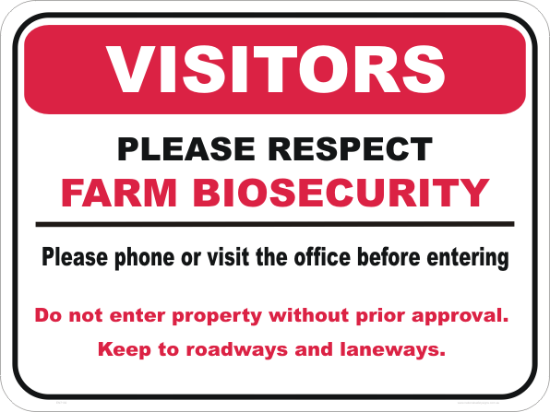
What Is Biosecurity?
Biosecurity= steps to help prevent the introduction and spread of disease
  Keeps your animals safe from the introduction of new germs
  Helps minimize the spread of existing germs
  Helps prevent sickness from spreading TO or FROM humans and animals

Slide 31
Biosecurity: What Can You Do?
Encourage healthy interactions between animals and people
  Ask people to wash their hands before and after handling your animals
  Discourage kissing animals, driving strollers through barns, using pacifiers that could be dropped, etc.
Keep human eating areas away from animal areas

Slide 32
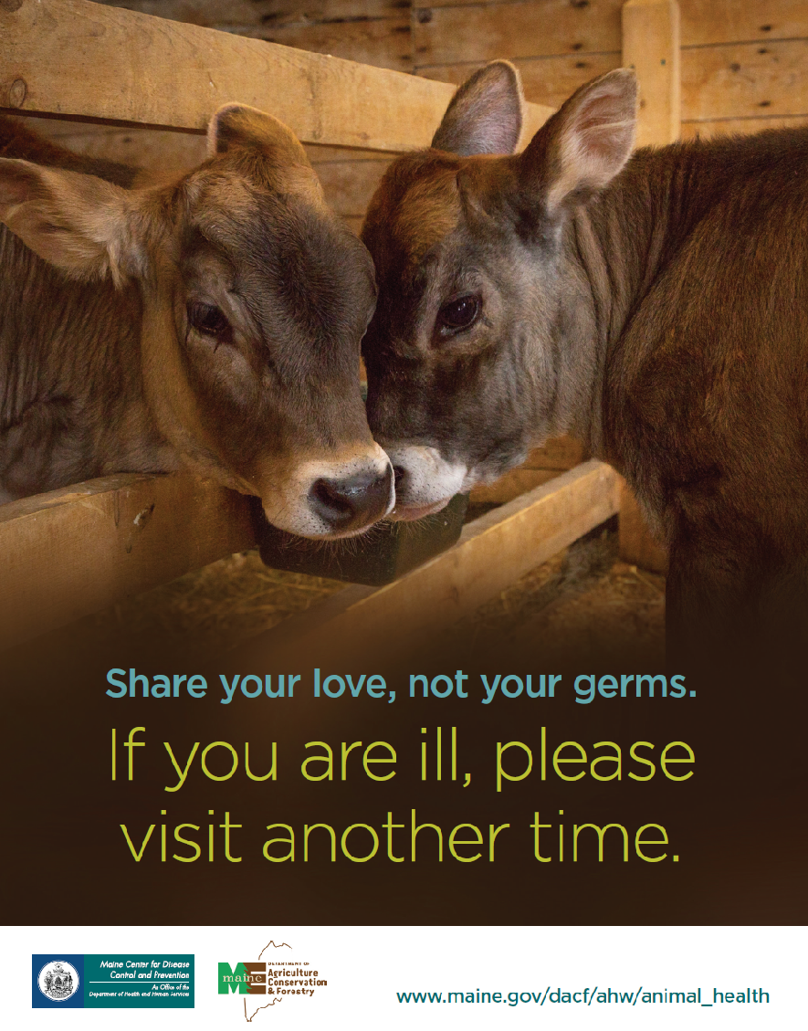
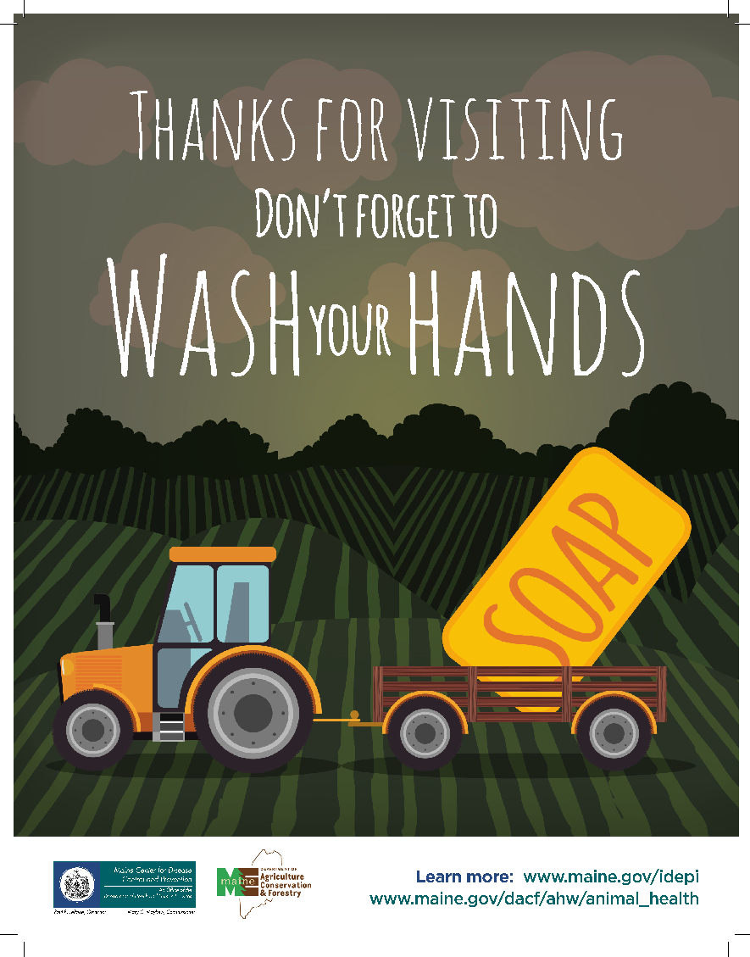
Biosecurity: What Can You Do?

Slide 33
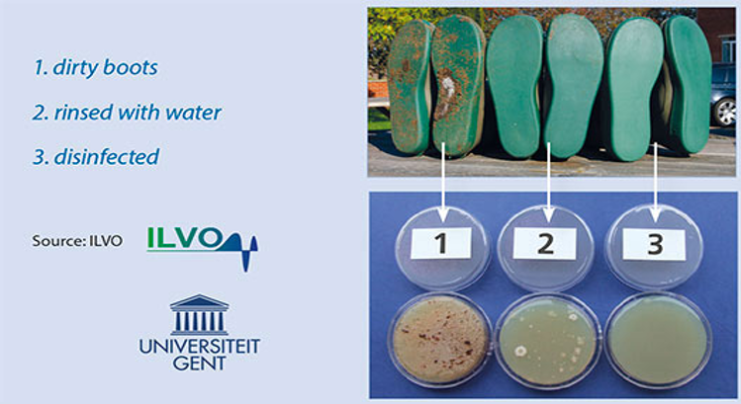
Biosecurity: What Can You Do?
Visitors can carry germs inside of the farm on their clothes, boots, their own bodies, or even their vehicles.
Visitors Should:
    Wear clean boots and clothes
    Stay out of the barn when sick
    Wash hands before and after
Photo courtesy of thepoultysite.com

Slide 34
Biosecurity: What Can You Do?
Do not share equipment with other farms
  Even healthy animals can pass germs
Keep your area clean and organized
Separate any animals who appear to possibly be sick
Do not bring suspected ill animals to fairs

Slide 35

Careers in Public Health
Public Health: Promotes health through prevention
  Behavioral science/health education
  Biostatistics
  Environmental health
  Epidemiology
  Health services administration
  Informatics
  Veterinary Science

Slide 36
Additional Information and Resources:
New Hampshire:
24 hr disease reporting line: 603-271-5300
www.dhhs.nh.gov/dphs/cdcs/index.htm
Maine:
24 hr disease reporting line: 1-800-821-5821
Influenza email: Influenza.dhhs@maine.gov
www.Maineflu.gov
www.maine.gov/idepi
Icons curtesy of Flaticon

