Slide 1
Biosecurity and Agritourism
(What I think you should know)
Dr. Justin Bergeron, BVMS MPH DACVPM
Assistant State Veterinarian
Maine Department of Agriculture, Conservation and Forestry

Slide 2
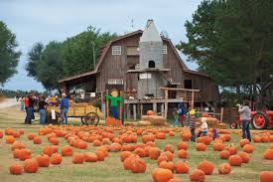
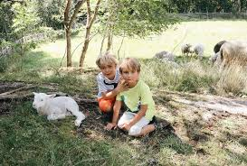
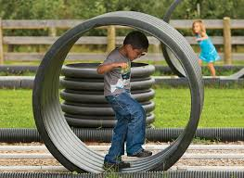
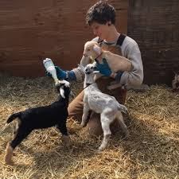
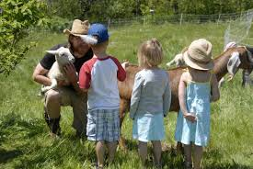
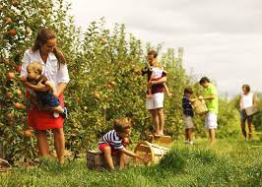
What is Agritourism?
Agritourism or agrotourism, as it is defined most broadly, involves any agriculturally based operation or activity that brings visitors to a farm or ranch.

Slide 3
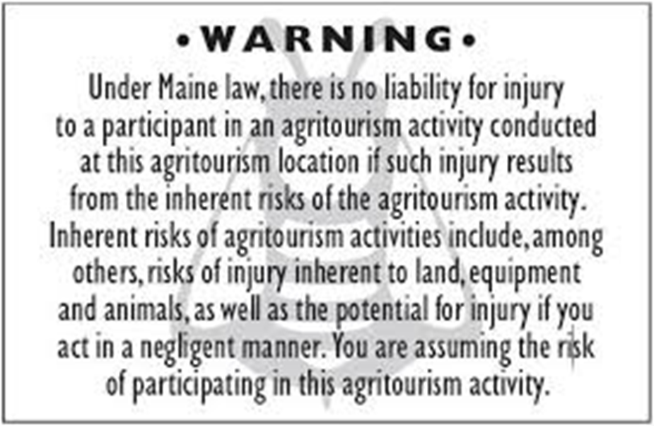


Slide 4

So what…….
“Why are we talking about biosecurity? my father didn't have these issues and he farmed for years!”
“I have been around animals all my life and have been eating in the barns. I never had a problem!”

Slide 5
Dr. B’s Rules for Staying Healthy
Remember rabies is real and really scary
Don’t eat poop
  Wash you hands
  Cook Stuff
Wear your PPE
You are not a naturalist, don’t touch things
No kissing, animals or people

Slide 6
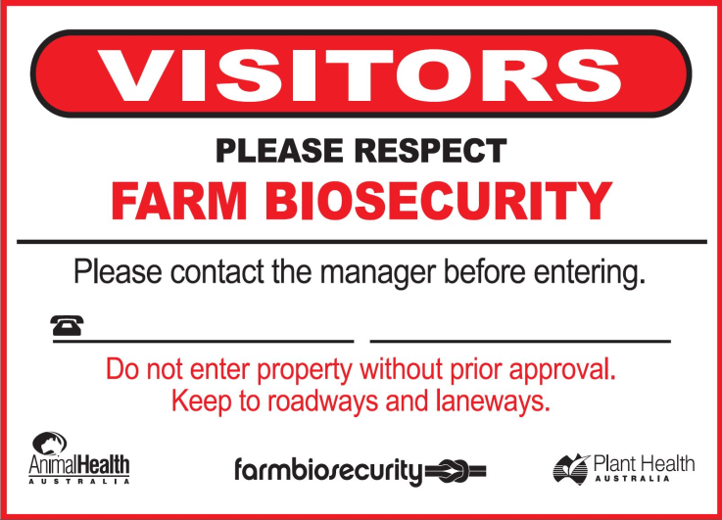
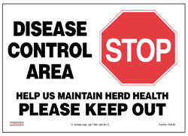
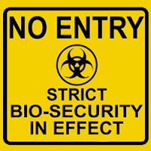
Biosecurity
Limiting
the risk …..
Thshsarchibull.blogspot.com
Cal-ila.org
Swinehealthalliance.com

Slide 7
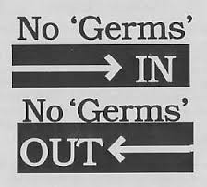

What is biosecurity ?
www.poultryhelp.com
The original definition of biosecurity started out as a set of preventive measures designed to reduce the risk of transmission of infectious diseases in crops and livestock, quarantined pests, invasive alien species, and living modified organisms (Koblentz, 2010).
The current definition: Biosecurity is a strategic and integrated approach that encompasses the policy and regulatory frameworks (including instruments and activities) that analyse and manage risks in the sectors of food safety, animal life and health, and plant life and health, including associated environmental risk
The easy definition of farm biosecurity - A series of management practices designed to minimize or prevent the importation of infectious agents onto a farm.

Slide 8
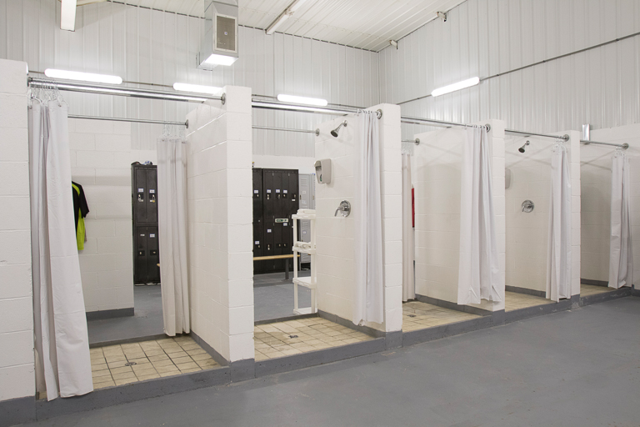
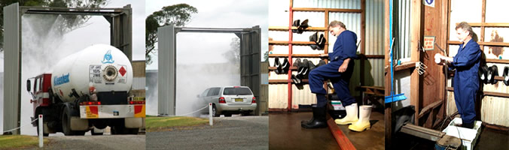
HMMMMM………

Slide 9
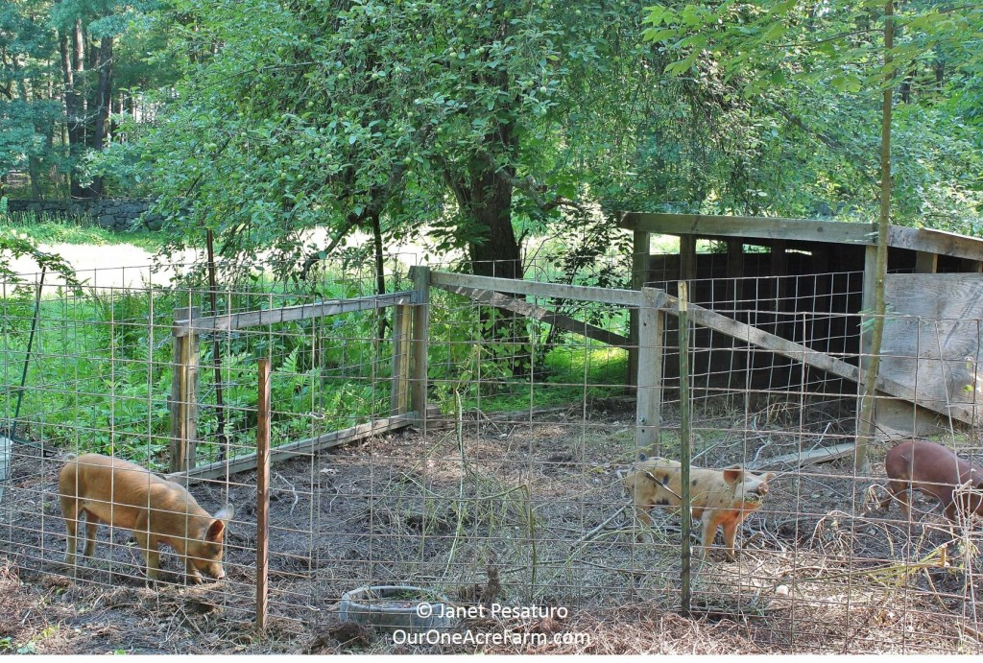
Or…………..

Slide 10
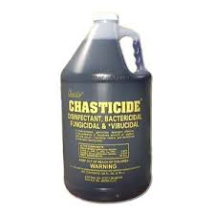
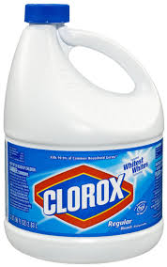
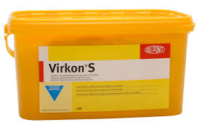
A Few Words About Disinfectants
Cleaning is not disinfection
Disinfectants vary in their activity against viruses, bacteria, fungi and protozoa that are commonly found in animal areas
Most disinfectants are inactivated by organic matter –dirt, manure, etc
Disinfectants must have contact time in order to work
Read the label
Notes:
10
10

Slide 11
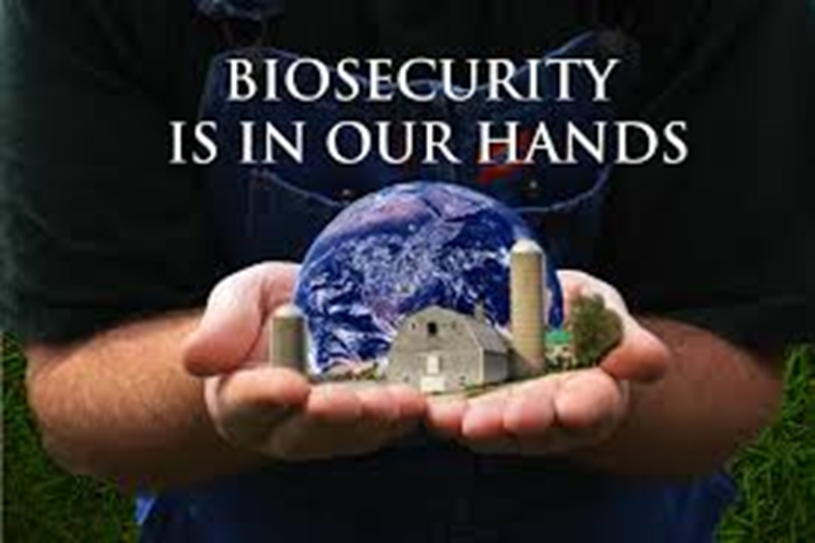
Biosecurity Plan
http://blog.uvm.edu/jmsmith/

Slide 12
Dr. B’s Rules for Staying Healthy
Remember rabies is real and really scary
Don’t eat poop
  Wash you hands
  Cook Stuff
Wear your PPE
You are not a naturalist, don’t touch things
No kissing, animals or people

Slide 13

Need some help?

Slide 14
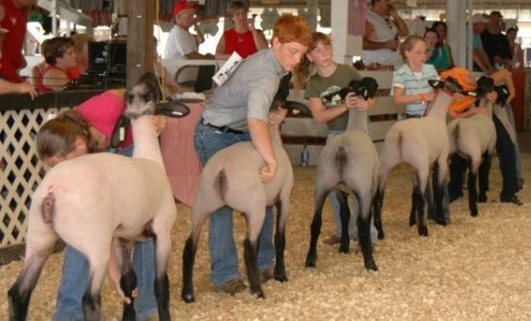
Questions ?

