Slide 1

2015 Shoreland Zoning Guidelines
Shoreland Zoning Workshop
2024
Colin Clark
Shoreland Zoning Coordinator
MAINE DEPARTMENT OF ENVIRONMENTAL PROTECTION
Protecting Maine’s Air, Land and Water
Notes:
Introduction: DEP, SZ

Slide 2
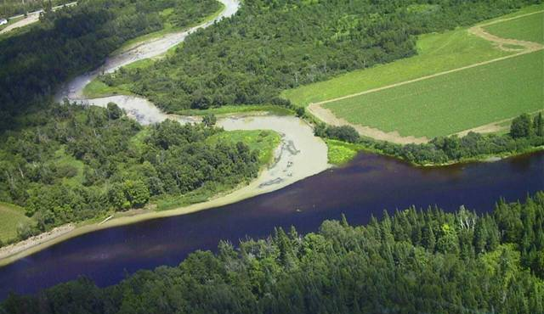
2015 Guidelines
1/26/15 amendments to Guidelines means:
Ordinances are not currently consistent
The Act requires ordinances to be consistent
Officials have choices to make about amendments
MAINE DEPARTMENT OF ENVIRONMENTAL PROTECTION www.maine.gov/dep
Notes:
This training will cover the recent changes in the Guidelines, not all the changes made in the 2006 Guidelines.
This will help you make choices in drafting amendments.

Slide 3
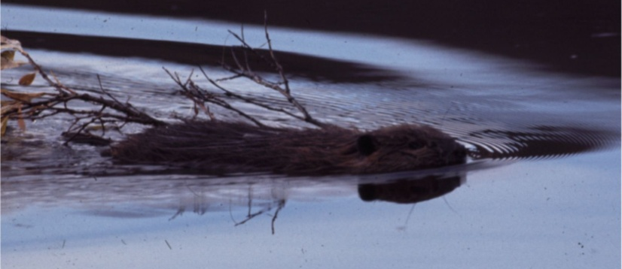
Implementation Roles
Municipality
Adopts/Amends ordinance
Administers ordinance
Enforces ordinance
Decides administrative and variance appeals
Maine DEP
Approves amendments
Provides advisory opinions
Provides enforcement assistance
Comments on variances
MAINE DEPARTMENT OF ENVIRONMENTAL PROTECTION www.maine.gov/dep
Notes:
CEOs are often involved in more than just enforcement

Slide 4
Timber Harvesting Options
Municipalities must choose one option:
Repeal local regulation (recommended by DEP)
  Limited local resources and/or limited harvesting activity
  Applicants and harvesters deal with one set of standards
Adopt statewide standards
  Local oversight desired, perhaps due to lots of harvesting activity
  Applicants and harvesters deal with one set of standards
Retain original standards
  Default by not repealing or adopting
  MFS will not assist with local administration of local standards
  Applicants and harvesters deal with two sets of standards
MAINE DEPARTMENT OF ENVIRONMENTAL PROTECTION www.maine.gov/dep
Notes:
Municipal officials have options on how timber harvesting is regulated

Slide 5
Minor Timber Harvesting Amendments for Option 2 Municipalities
Standards:
  bridge & culvert sizing (25-yr storm; 3x cross-sectional area
Definitions:
  Bureau of Forestry
  timber harvesting
MAINE DEPARTMENT OF ENVIRONMENTAL PROTECTION www.maine.gov/dep
Notes:
Even if the local ordinance was amended recently, amendments are required to be consistent with 2015 Guidelines.
Until amendment is approved by DEP enforce currently effective ordinance

Slide 6
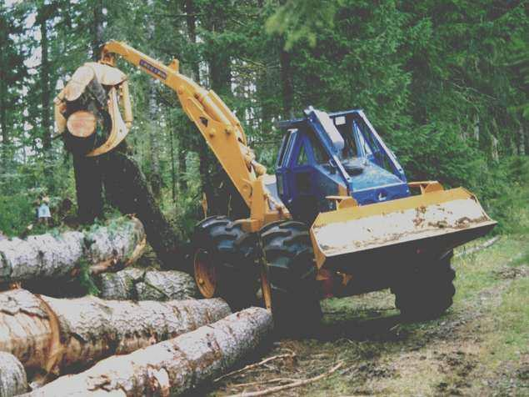
Timber Harvesting
Defined as:
the cutting and removal of timber for the primary purpose of selling or processing forest products
Does NOT include removal in the shoreland zone:
associated with any other land use activity
on a lot that has less than 2 acres
within the shoreland zone
MAINE DEPARTMENT OF ENVIRONMENTAL PROTECTION www.maine.gov/dep
Notes:
Reminder on the definition of timber harvesting, that may also need to be amended to be consistent with 2015 Guidelines

Slide 7
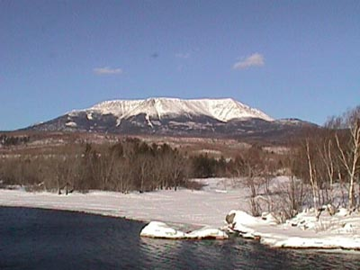
Individual Private Campsites
Vacant lot: one campsite per lot…or 30,000sf
Lot with an existing principal use or structure:
  requirements met for that principal use or structure, and
  Additional 30,000sf of lot area required per individual private campsite
MAINE DEPARTMENT OF ENVIRONMENTAL PROTECTION www.maine.gov/dep
Notes:
Amend local ordinances so this is clarified

Slide 8
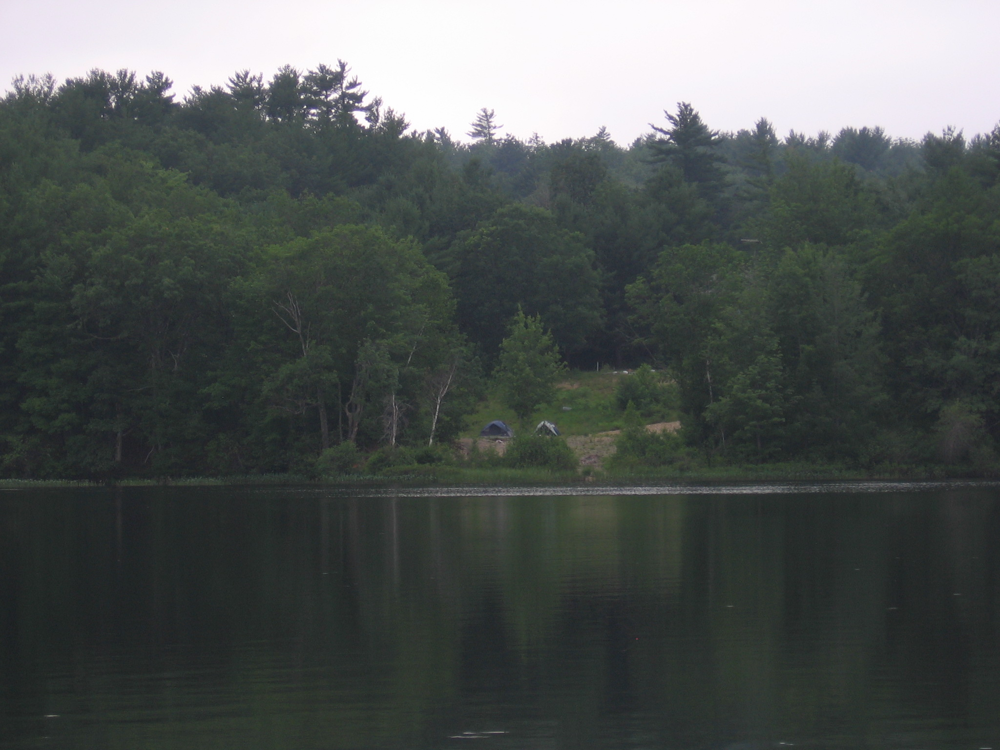
Individual Private Campsites
MAINE DEPARTMENT OF ENVIRONMENTAL PROTECTION www.maine.gov/dep
Notes:
Amend local ordinances so this is clarified

Slide 9
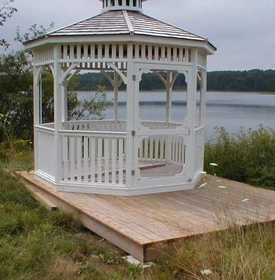
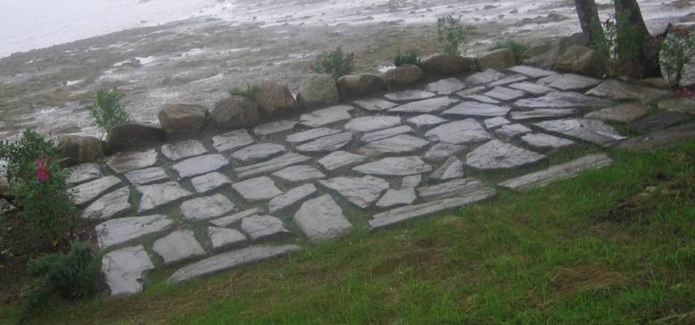
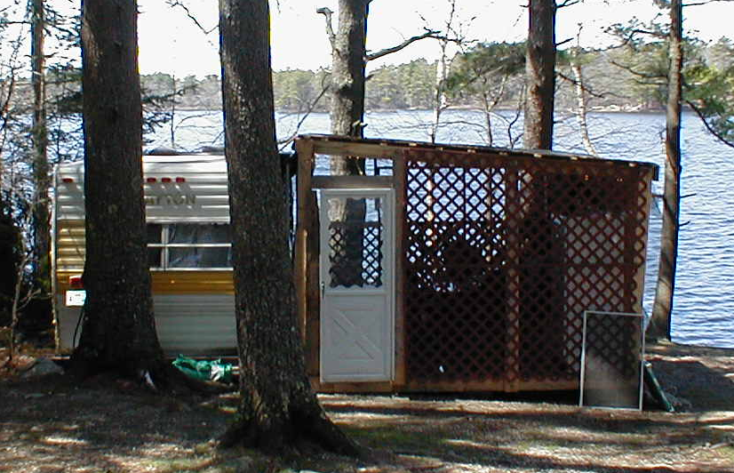
Structures Defined
Amend definition:
Anything temporarily or permanently located, built, constructed or erected for the support, shelter or enclosure of persons, animals, goods or property of any kind or anything constructed or erected on or in the ground…
- Structure does not include subsurface wastewater disposal systems.
MAINE DEPARTMENT OF ENVIRONMENTAL PROTECTION www.maine.gov/dep
Notes:
Even temporary structures must meet structure standards

Slide 10
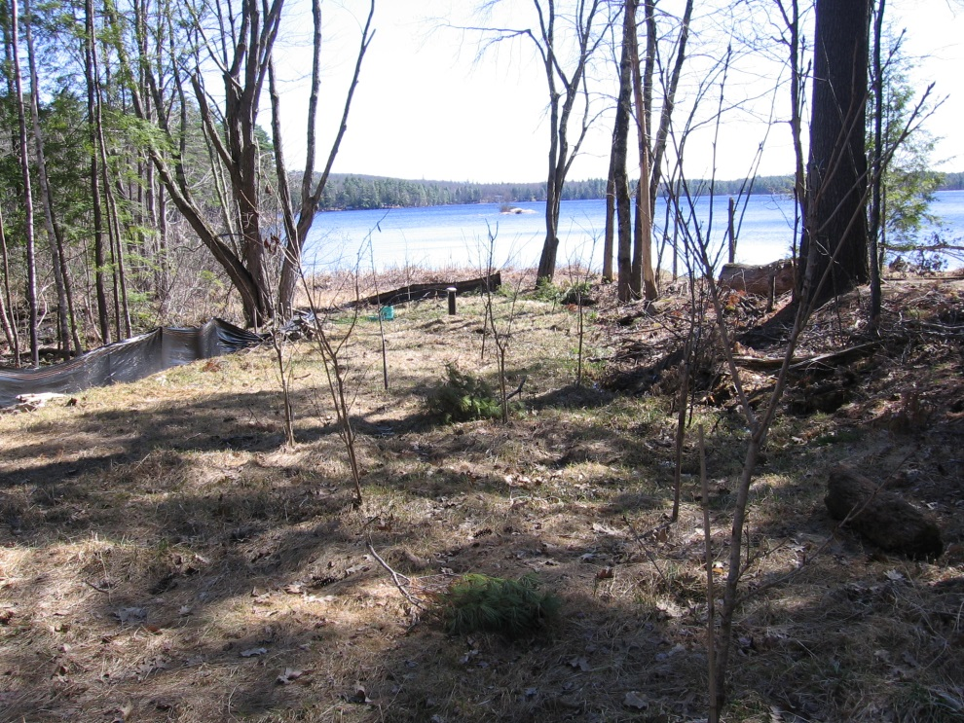
Definition Options
Optional exemptions from definition of structure:
fences, poles and equipment for service drops
geothermal heat exchange wells
wells or water wells
MAINE DEPARTMENT OF ENVIRONMENTAL PROTECTION www.maine.gov/dep
Notes:
Typical exemptions include fences, poles and equipment for service drops
Other exemptions are new

Slide 11
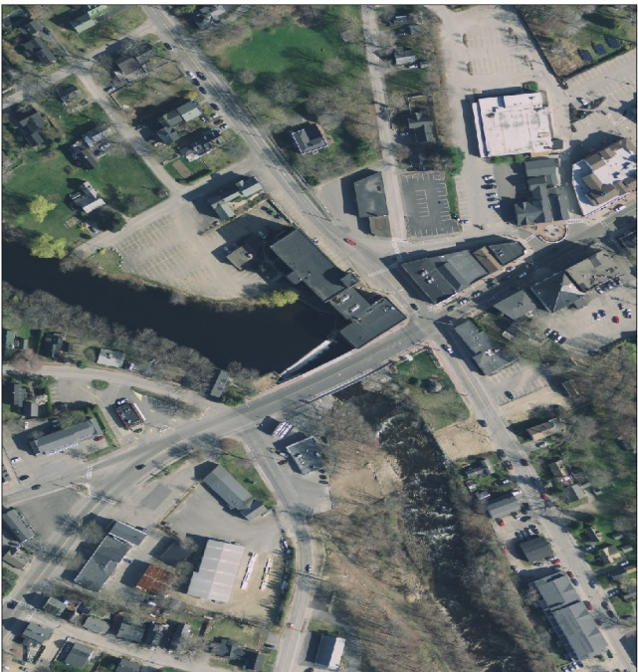
Decks over Rivers
Optional exemption from setbacks:
Downtown revitalization along a river
Pre-1971 commercial structure not meeting setbacks
An attached, cantilevered deck allowed
  No more than 700 square feet
  Meets all other standards except setbacks
MAINE DEPARTMENT OF ENVIRONMENTAL PROTECTION www.maine.gov/dep
Notes:
Applicability very limited

Slide 12
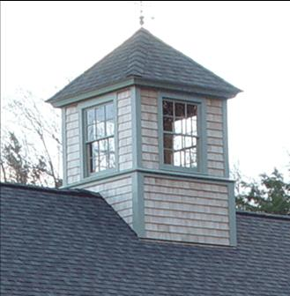
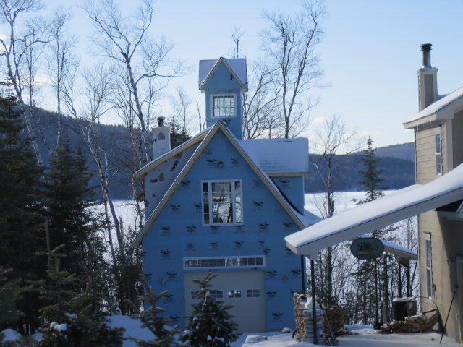
Height Exemptions
Optional exemptions:
chimneys, steeples, antennas, and similar appurtenances
transmission towers, windmills, antennas, and similar structures
a non-habitable feature such as a cupola, a dome or a widow’s walk, provided certain conditions are met
MAINE DEPARTMENT OF ENVIRONMENTAL PROTECTION www.maine.gov/dep
Notes:
Municipal officials may choose to include any or all of these exemptions from being included in the measurement of height.

Slide 13
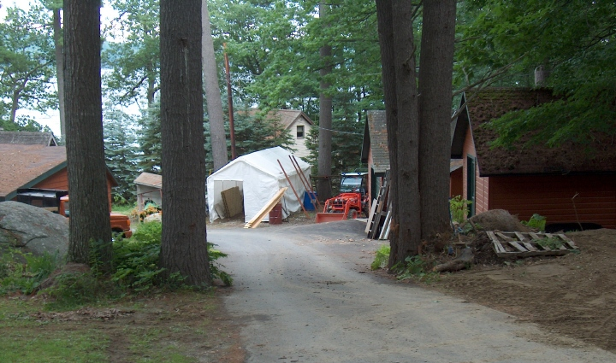
Non-Vegetated Surfaces
Total area is limited as percentage of lot area:
20% in most shoreland zone districts
70% in shoreland zone of coastal wetlands and rivers not flowing to great ponds where district is CFMA or GD
MAINE DEPARTMENT OF ENVIRONMENTAL PROTECTION www.maine.gov/dep
Notes:
Purpose
Prevent unintentional violations by requiring depiction on site plans
This standard often varies municipality to municipality

Slide 14
Non-veg. Surfaces & Exemptions
Surfaces include:
Structures
Parking areas
Lands previously developed
2015 Guidelines
Structures
Driveways
Parking areas
Other areas from which vegetation was removed
Optional exemptions:
Naturally occurring ledge and rock outcroppings- lots existing on 3/24/90
Public boat launching facilities
*No exemption for grass paver type products
MAINE DEPARTMENT OF ENVIRONMENTAL PROTECTION www.maine.gov/dep
Notes:
Not just impervious surfaces.
Municipal officials may choose to include any or all of these exemptions from being included in the measurement of total non-vegetated surfaces

Slide 15
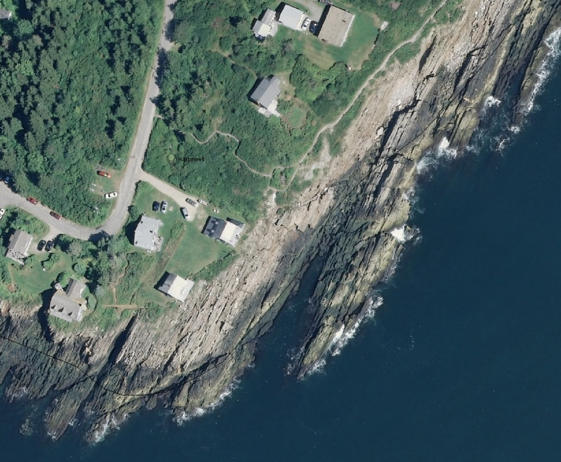
Naturally Occurring Ledge…
MAINE DEPARTMENT OF ENVIRONMENTAL PROTECTION www.maine.gov/dep

Slide 16
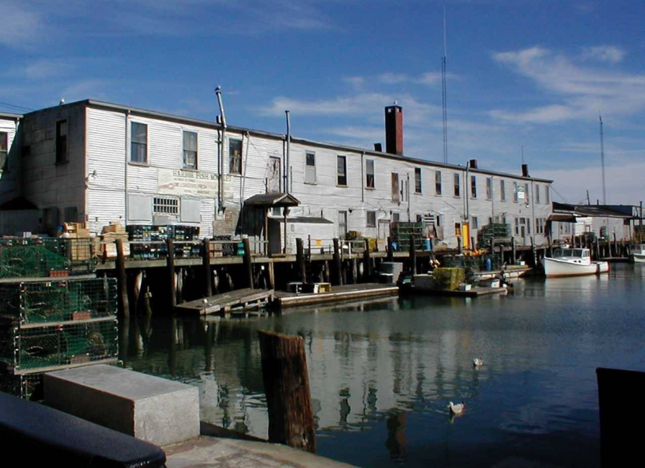
Definition
Amend definition of functionally water-dependent:
Correct inclusion of fish-related storage
Include shoreline structures necessary for erosion control purposes (in place of retaining walls)
Correct exclusion of recreational boat storage buildings
MAINE DEPARTMENT OF ENVIRONMENTAL PROTECTION www.maine.gov/dep
Notes:
To be consistent with revisions in the Act

Slide 17
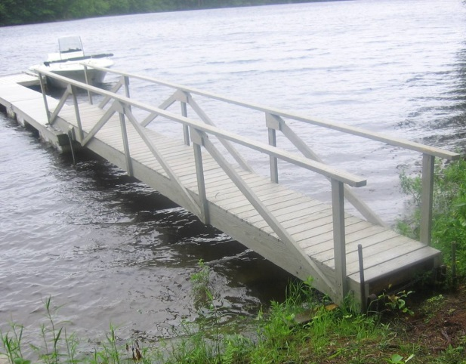
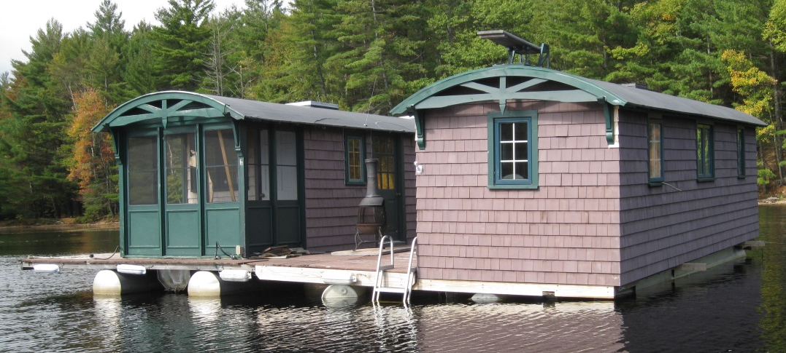
Structures Below the Shoreline
If regulated in your municipality, new changes:
One structure (dock) per lot, but optional exception:
  Two structures allowed if lot has double the frontage required
New note:
  A structure on floats is prohibited unless it is designed to function as, and is registered as, a watercraft.
MAINE DEPARTMENT OF ENVIRONMENTAL PROTECTION www.maine.gov/dep
Notes:
Most municipal ordinances apply to structures extending or located below the normal high-water line or within a wetland, such as piers and docks. If the ordinance applies, then standards are required.

Slide 18
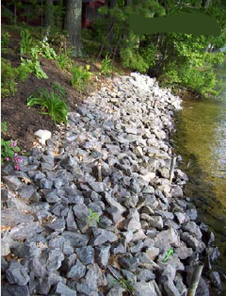
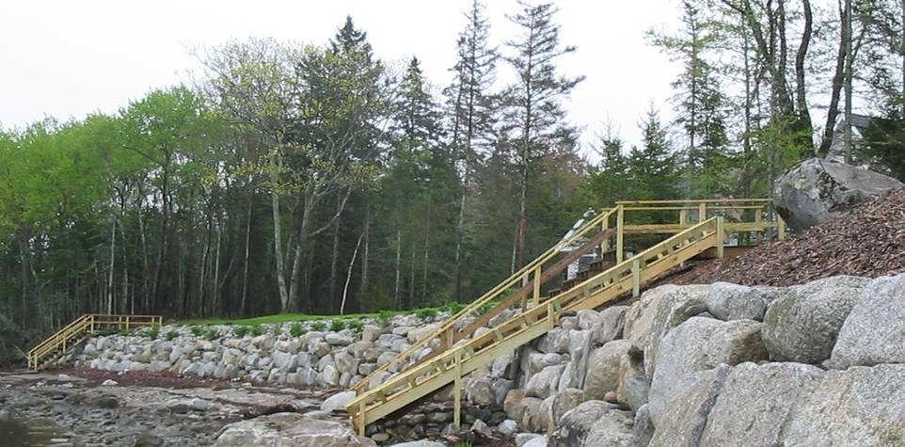
Shoreline Stabilization
New standards:
Planning board review
Access by barge if feasible
Vegetation removal limited
Revegetation required
MAINE DEPARTMENT OF ENVIRONMENTAL PROTECTION www.maine.gov/dep
Notes:
Shoreline stabilization projects occur mostly above the shoreline. These standards are required.

Slide 19
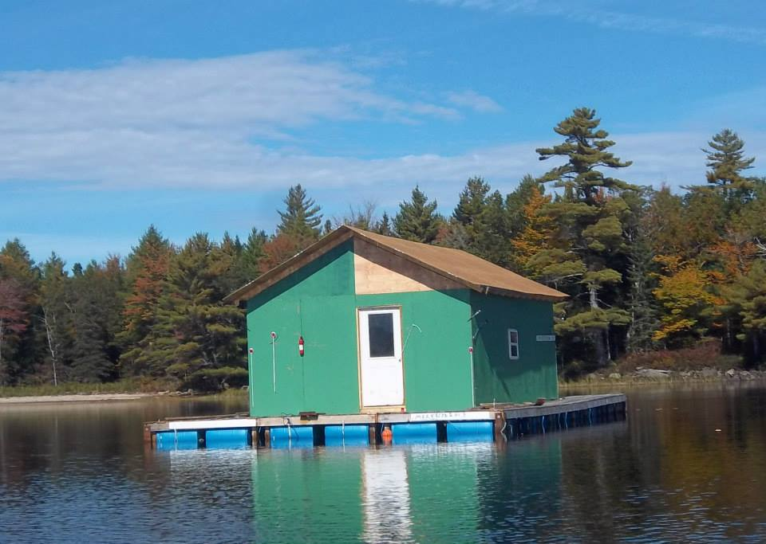
Functionally Water-Dependent:
Problems…
MAINE DEPARTMENT OF ENVIRONMENTAL PROTECTION www.maine.gov/dep
Notes:
Alternatively, separate state statute gives board of appeals the authority to issue disability variance

Slide 20
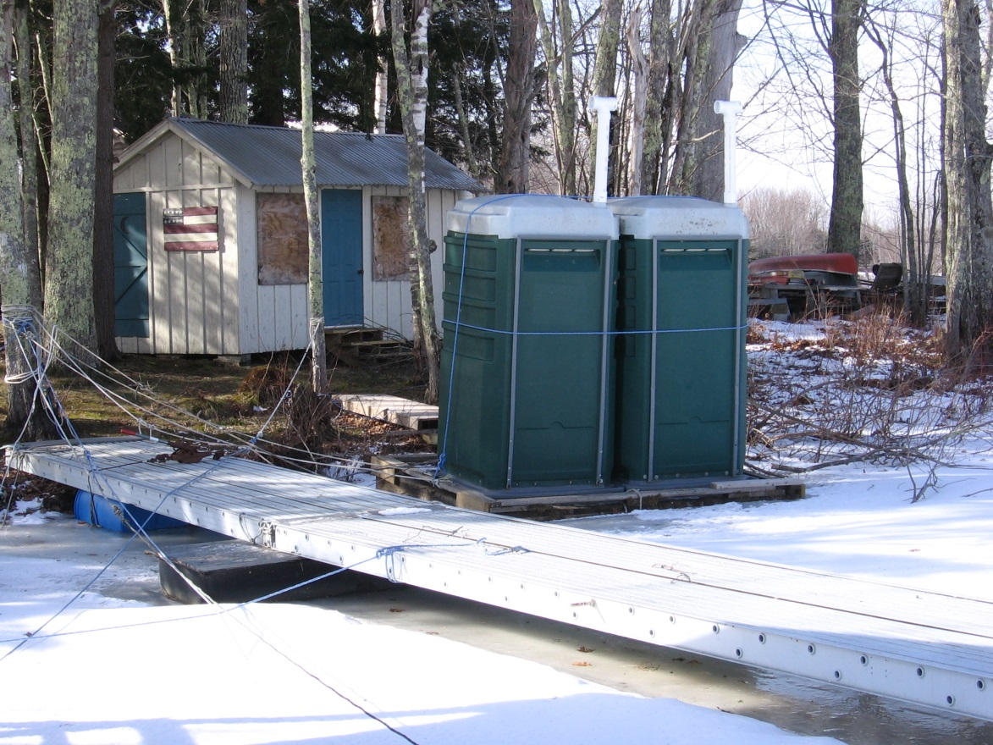
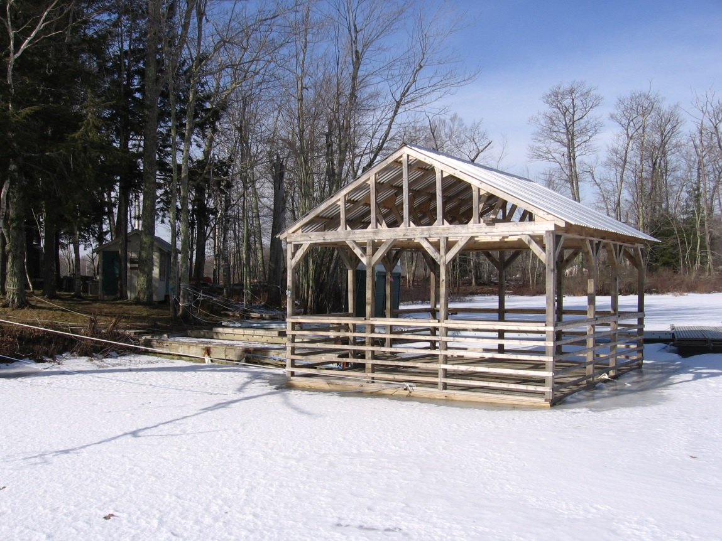
Functionally Water-Dependent:
Problems…
MAINE DEPARTMENT OF ENVIRONMENTAL PROTECTION www.maine.gov/dep
Notes:
Alternatively, separate state statute gives board of appeals the authority to issue disability variance

Slide 21
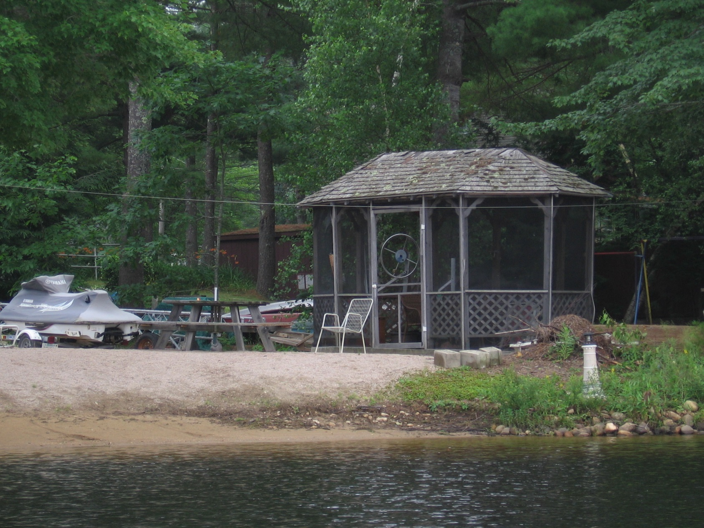
Functionally Water-Dependent?
MAINE DEPARTMENT OF ENVIRONMENTAL PROTECTION www.maine.gov/dep
Notes:
Alternatively, separate state statute gives board of appeals the authority to issue disability variance

Slide 22
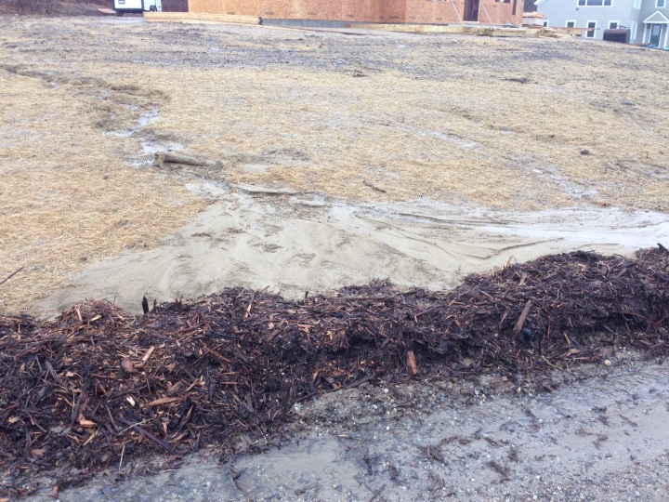
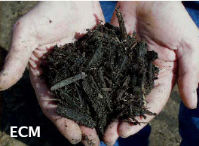
Certified Contractors
Consistent with the Act, ordinance should require:
A certified person be on-site to oversee controls
When an excavation contractor performs activities disturbing more than one cubic yard of soil
Request Cert. # on permit applications
MAINE DEPARTMENT OF ENVIRONMENTAL PROTECTION www.maine.gov/dep
Notes:
Besides required standards, municipal officials may choose whether to administer and enforce required certification for contractors.

Slide 23
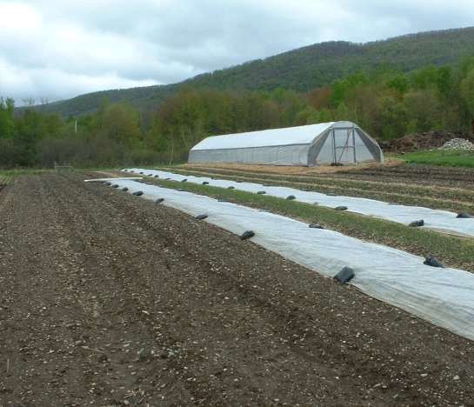
Excavation Contractor
Add definition, which excludes:
Municipal, State, and federal employees conducting work associated w/their employment
Timber harvesters conducting timber harvests
Farmers conducting agriculture activities
Homeowners doing work themselves
MAINE DEPARTMENT OF ENVIRONMENTAL PROTECTION www.maine.gov/dep
Notes:
If the requirement is added, add the definition also

Slide 24
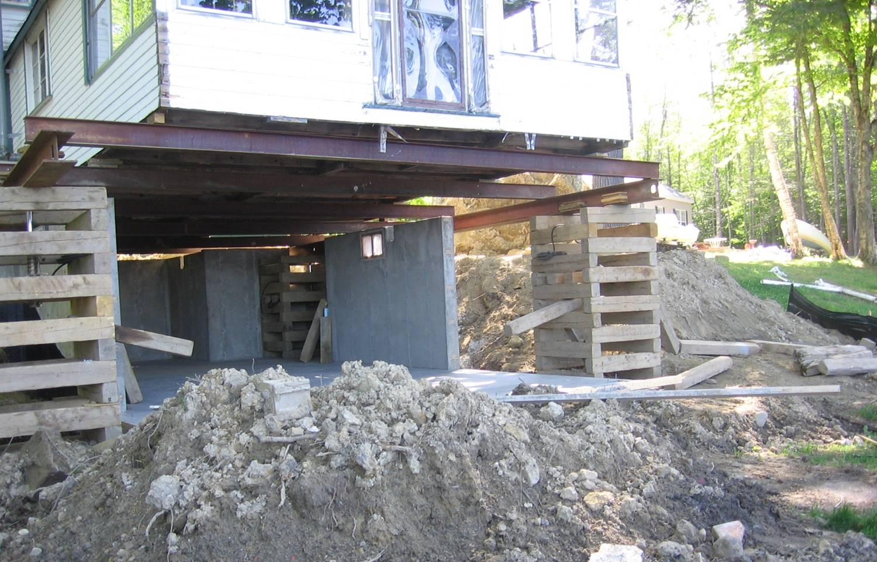
Reconstruction Standards
In-place reconstruction/replacement if:
< 50% of the market value of the structure is removed, damaged, or destroyed
Relocation required if:
> 50% of the market
value of the structure
is removed, damaged,
or destroyed
MAINE DEPARTMENT OF ENVIRONMENTAL PROTECTION www.maine.gov/dep
Notes:
Most projects are obvious, but use your professional judgement.
The applicant has the burden of proof.

Slide 25
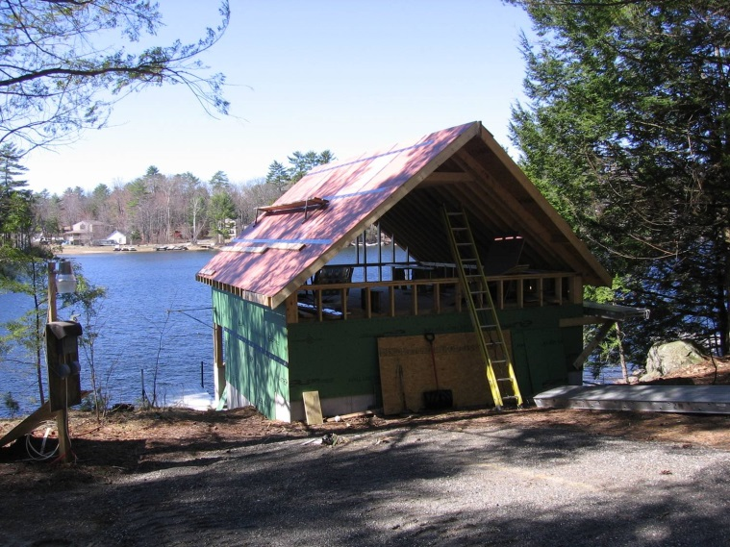
Relocation Review
When relocation is required:
The reviewing authority determines where the existing structure could be relocated to meet the setback to the greatest practical extent
Criteria for making this determination includes:
Characteristics of the land and lot
Locations of existing structures
Existing and future septic systems
The condition of existing foundation
Seek advisory opinions
MAINE DEPARTMENT OF ENVIRONMENTAL PROTECTION www.maine.gov/dep
Notes:
Make sure the application demonstrates all limitations to meeting the setback.
Criteria can be tricky or subjective, so seek assistance when needed.

Slide 26
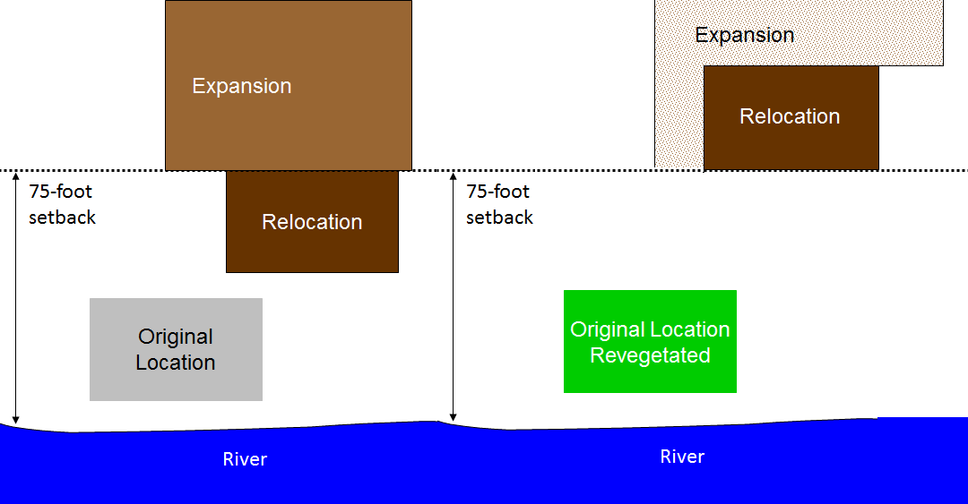
Relocation First
Relocate original structure
to meet setback
Not Greatest Practical Extent
MAINE DEPARTMENT OF ENVIRONMENTAL PROTECTION www.maine.gov/dep
Notes:
When expansion is proposed, and relocation is proposed or required, then the relocation evaluation is done before expansion is considered.
Ordinances amended since 2006 require the original location to be revegetated.

Slide 27
NEW!! Footprint and Height Method
Change from floor area and volume to “footprint” and height- tiered, based on distance from shore
Landowners choose between the cap limit or 30% for footprint, and existing height or height cap
Plans recorded at registry of deeds
Municipal officials may choose to:
Limit expansions by the caps or by 30%, instead of allowing landowner choice
Allow limited expansions within 25 feet of the shoreline
Allow limited expansions in Resource Protection District
MAINE DEPARTMENT OF ENVIRONMENTAL PROTECTION www.maine.gov/dep
Notes:
Difference b/t floor area and footprint
Difference b/t volume and height

Slide 28
What is “Footprint”?
Footprint - the entire area of ground covered by the structure(s) on a lot, including but not limited to cantilevered or similar overhanging extensions, as well as unenclosed structures, such as patios and decks
MAINE DEPARTMENT OF ENVIRONMENTAL PROTECTION www.maine.gov/dep

Slide 29
Other Definitions using “Footprint”
Expansion of a structure, change floor area & volume
Expansion of a use, change floor area
Floor area, remove reference to unenclosed structures
Nonconforming structure, add footprint
MAINE DEPARTMENT OF ENVIRONMENTAL PROTECTION www.maine.gov/dep

Slide 30
Footprint expansion-highlights
Height- existing, or max height:
100 feet
75 feet
25 feet
No expansion unless principal structure entirely w/in 25’, then 800 sf or 30%. No accessory structure expansion.
15 ft
Great Pond
Notes:
This rule is an option for the town to adopt and then administer in place of 30% rule.

Slide 31
Footprint expansion- highlights
Height- existing, or max height:
100 feet
75 feet
Expansion up to 1,000 sf, or 30%, whichever is greater (maximum combined total footprint). No accessory structure expansion if closer to shoreline than principal structure.
20 ft
25 feet
No expansion unless principal structure entirely w/in 25’, then 800 sf or 30%. No accessory structure expansion.
15 ft
Great Pond
Notes:
This rule is an option for the town to adopt and then administer in place of 30% rule.

Slide 32
Footprint expansion- highlights
Height- existing, or max height:
100 feet
Expansion up to 1,500 sf, or 30%, whichever is greater (maximum combined total footprint). No accessory structure expansion if closer to shoreline than principal structure.
25 ft
75 feet
Expansion up to 1,000 sf, or 30%, whichever is greater (maximum combined total footprint). No accessory structure expansion if closer to shoreline than principal structure.
20 ft
25 feet
No expansion unless principal structure entirely w/in 25’, then 800 sf or 30%. No accessory structure expansion.
15 ft
Great Pond
Notes:
This rule is an option for the town to adopt and then administer in place of 30% rule.

Slide 33
Footprint expansion- highlights
Height- existing, or max height:
75 feet
Expansion up to 1,000 sf, or 30%, whichever is greater (maximum combined total footprint). No accessory structure expansion if closer to shoreline than principal structure.
20 ft
25 feet
No expansion unless principal structure entirely w/in 25’, then 800 sf or 30%. No accessory structure expansion.
15 ft
Coastal or Freshwater Wetland, River, Stream, Tributary Stream
Notes:
This rule is an option for the town to adopt and then administer in place of 30% rule.

Slide 34
Footprint expansion- highlights
Resource Protection District
Height- existing, or max height:
250 feet
Expansion up to 1,500 sf, or 30%, whichever is greater (maximum combined total footprint). No accessory structure expansion if closer to shoreline than principal structure.
25 ft
75 feet
15 or 20 ft
Same expansion thresholds as for other districts
Great Pond
Notes:
This rule is an option for the town to adopt and then administer in place of 30% rule.

Slide 35
1) What can be expanded?
Height- existing, or max height:
500 sf
garage
100 feet
1500 sf cap or 30%
25 ft
75 feet
1000 sf cap or 30%
20 ft
200 sf
shed
25 feet
800 sf camp
800 sf cap or 30%
15 ft
Great Pond
Notes:
This rule is an option for the town to adopt and then administer in place of 30% rule.

Slide 36
1) Answer: rear of camp or shed (30%), and garage
Height- existing, or max height:
500 sf
garage
100 feet
1500 sf cap or 30%
25 ft
75 feet
1000 sf cap or 30%
20 ft
200 sf
shed
25 feet
no expansion
800 sf camp
800 sf cap or 30%
15 ft
Great Pond
Notes:
This rule is an option for the town to adopt and then administer in place of 30% rule.

Slide 37
2) What can be expanded?
Height- existing, or max height:
100 feet
1500 sf cap or 30%
25 ft
75 feet
1000 sf cap or 30%
20 ft
200 sf
shed
25 feet
800 sf camp
500 sf
garage
800 sf cap or 30%
15 ft
Great Pond
Notes:
This rule is an option for the town to adopt and then administer in place of 30% rule.

Slide 38
2) Answer: camp and/or shed (30%).
Camp cannot add garage footprint.
Height- existing, or max height:
100 feet
1500 sf cap or 30%
25 ft
75 feet
1000 sf cap or 30%
20 ft
200 sf
shed
Accessory structures <25’: no expansion
25 feet
800 sf camp
500 sf
garage
800 sf cap or 30%
15 ft
Great Pond
Notes:
This rule is an option for the town to adopt and then administer in place of 30% rule.

Slide 39
3) What can be expanded?
Height- existing, or max height:
100 feet
1500 sf cap or 30%
25 ft
75 feet
800 sf camp
1000 sf cap or 30%
20 ft
500 sf
garage
25 feet
200 sf
shed
800 sf cap or 30%
15 ft
Great Pond
Notes:
This rule is an option for the town to adopt and then administer in place of 30% rule.

Slide 40
3) Answer: camp only (30% of total footprint
of all structures)
Height- existing, or max height:
100 feet
1500 sf cap or 30%
25 ft
75 feet
800 sf camp
1000 sf cap or 30%
20 ft
accessory w/in 25’: no expansion
500 sf
garage
25 feet
accessory structures closer than principal structure: no expansion
200 sf
shed
800 sf cap or 30%
15 ft
Great Pond
Notes:
This rule is an option for the town to adopt and then administer in place of 30% rule.

Slide 41
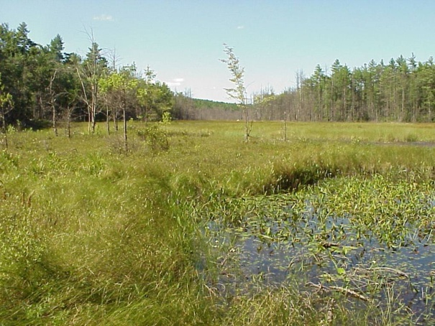
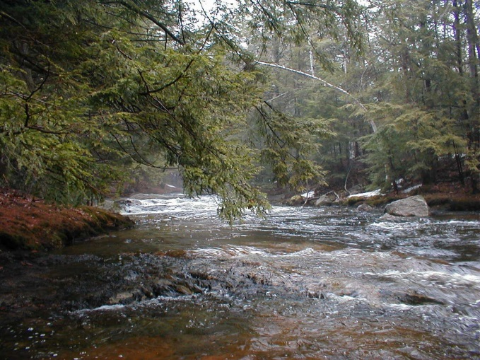
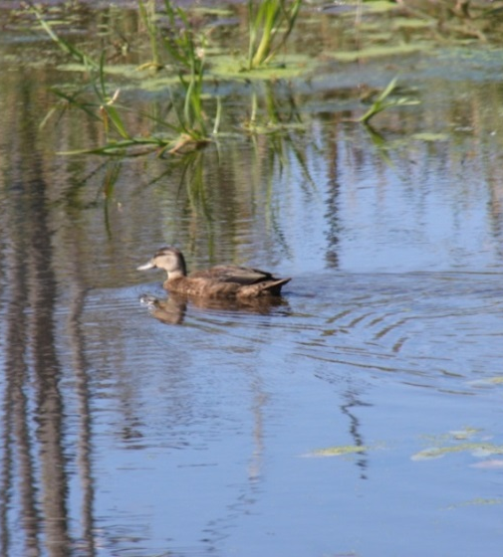
Vegetation Purposes
Vegetation is the cheap and natural way to:
Intercept and infiltrate stormwater runoff
Slow and control soil erosion and sedimentation
Provide bird & wildlife habitat, and shade aquatic habitat
Keep privacy and conserve natural character of Maine
MAINE DEPARTMENT OF ENVIRONMENTAL PROTECTION www.maine.gov/dep
Notes:
Vegetation standards help achieve shoreland purposes

Slide 42
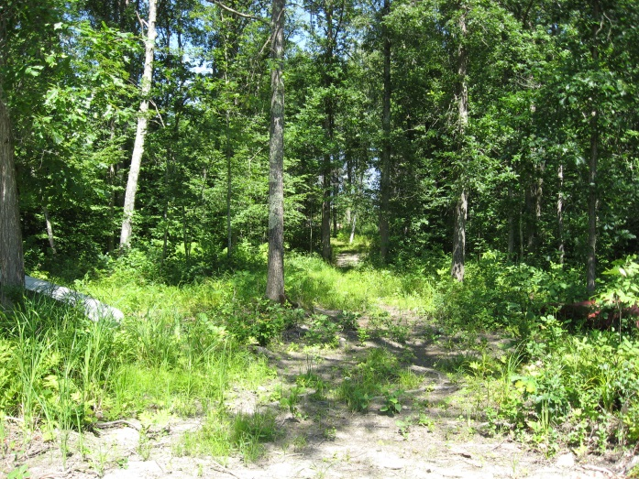
Vegetation Definitions
New definitions for:
Sapling – a tree species that is less than 2” in diameter
Seedling – a tree species that is less than 4.5 ft in height
Tree – a woody perennial plant that has a well-defined trunk(s) at least 2” in diameter…a more or less definite crown and reaches a height of at least 10ft at maturity
MAINE DEPARTMENT OF ENVIRONMENTAL PROTECTION www.maine.gov/dep

Slide 43
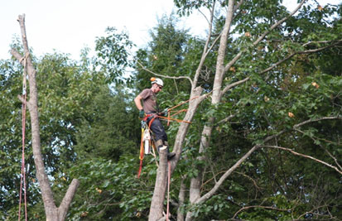
Hazard Trees
Within shoreline buffer:
Replace tree canopy opening > 250sf
  new tree growth present or
  Plant native trees at least 4ft in height and 2in DBH
No stump removal
CEO may require:
Professional evaluation
>1:1 for >8in DBH trees
Outside buffer:
Replace if tree volume or cleared openings exceeded
With new tree growth or
  With native trees at least 2in DBH
MAINE DEPARTMENT OF ENVIRONMENTAL PROTECTION www.maine.gov/dep
Notes:
Consultation with CEO required
Municipal officials may choose to make standards more restrictive

Slide 44
Hazard Tree Defined
Add new definition for hazard tree:
structural defect…
under the normal range of environmental conditions, not:
  hurricanes, hurricane-force winds,
  tornados, microbursts, or
  significant ice storm events
exhibits a high probability of failure…
will strike a target.
  Area where personal injury or property damage could occur
  roads, driveways, parking areas, structures, campsites, and any other developed area where people frequently gather and linger
also trees that pose imminent risk to bank stability.
MAINE DEPARTMENT OF ENVIRONMENTAL PROTECTION www.maine.gov/dep
Notes:
Defect that would result in failure under normal conditions, AND will strike a target. Without a target, it is not a hazard tree, except for trees posing a serious and imminent risk to bank stability.

Slide 45
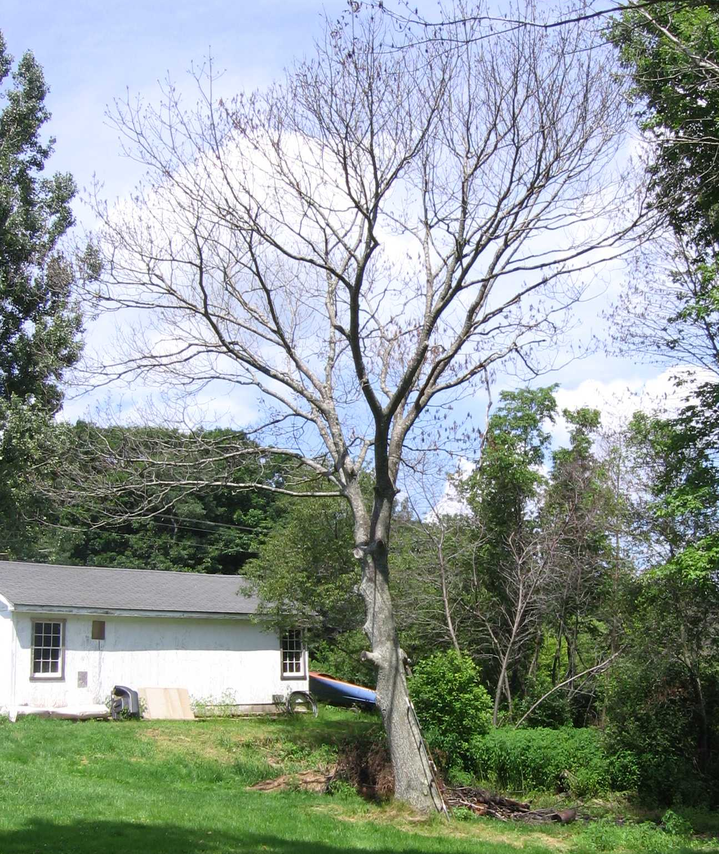
Dead Trees
Dead trees – contain no foliage during the growing season:
Removal allowed if dead from natural causes
No creation of new lawn areas or other permanently cleared areas
No stump removal
MAINE DEPARTMENT OF ENVIRONMENTAL PROTECTION www.maine.gov/dep
Notes:
No permit or consultation
Municipal officials may choose to make standards more restrictive

Slide 46
Storm-Damaged Trees
Within shoreline buffer:
Pruning damaged limbs above 1/3 allowed
Replace tree canopy opening > 250sf
  By natural regeneration or
  With native seedlings or saplings, 1 per 80sf
No creation of new lawn or other cleared areas
No stump removal
Outside buffer:
Replace tree volume or cleared openings
  By natural regeneration
  With native seedlings or saplings on 1:1 basis
Regeneration must occur within 1 season
MAINE DEPARTMENT OF ENVIRONMENTAL PROTECTION www.maine.gov/dep
Notes:
Consultation with CEO required
Municipal officials may choose to make standards more restrictive

Slide 47
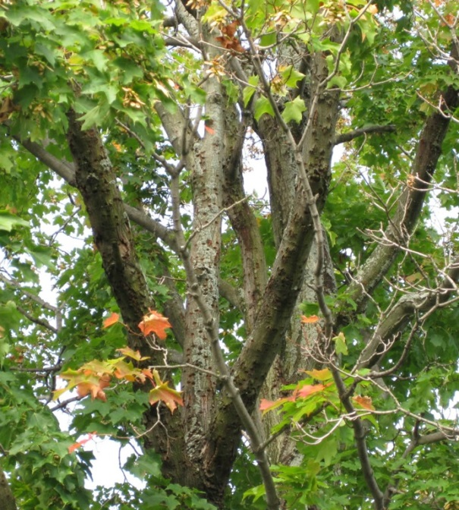
Storm-Damaged Tree Definition
Add new definition for storm-damaged tree:
a tree that is damaged beyond the point of recovery
as a result of a storm event.
Could be uprooted, blown down, lying on the ground, or still standing
MAINE DEPARTMENT OF ENVIRONMENTAL PROTECTION www.maine.gov/dep

Slide 48
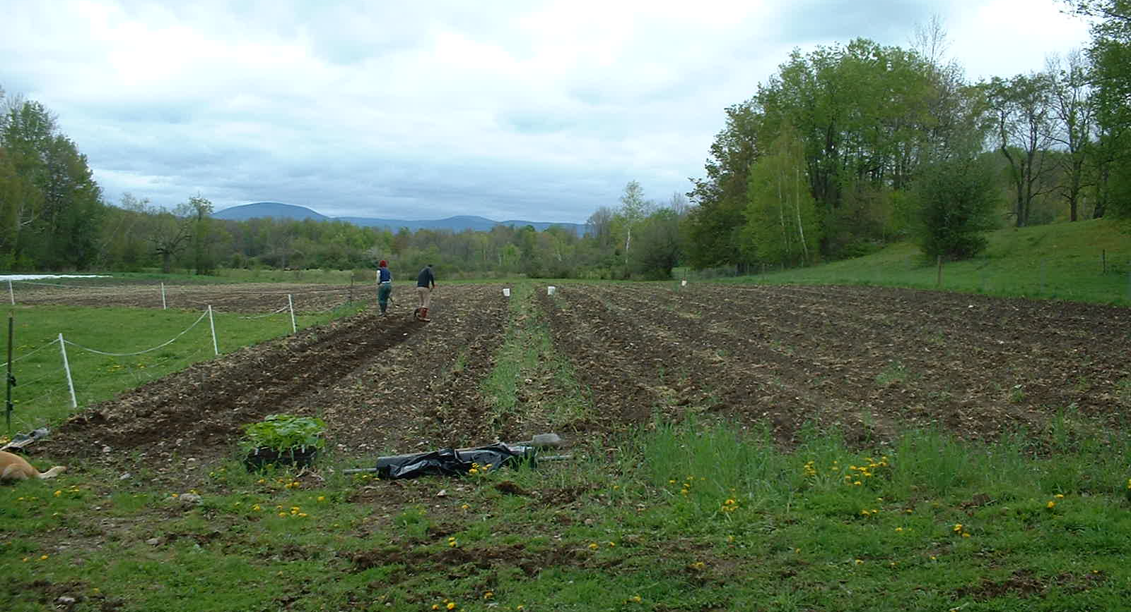
Exemptions from Standards
Section for exemptions from vegetation standards:
Existing cleared areas: maintenance cutting required
Permitted activities: where shoreline setbacks are n/a
Agriculture: when BMPs used & standards met
MAINE DEPARTMENT OF ENVIRONMENTAL PROTECTION www.maine.gov/dep
Notes:
Exemptions used to be spread throughout vegetation standards and elsewhere in the ordinance. Now, they are contained in one section.

Slide 49
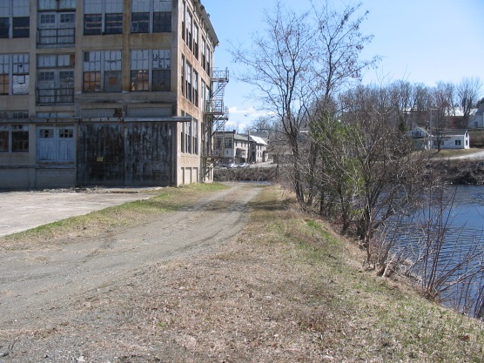
Brownfields & VRAP
Exemptions from vegetation standards, cont…:
Brownfields & Voluntary Response Action Program
Within the shoreland zone of a coastal wetland or a river that does not flow to a great pond
Zone must be designated as a General Development or Commercial Fisheries / Maritime Activities District
Only when necessary for remediation activities to clean up contamination
MAINE DEPARTMENT OF ENVIRONMENTAL PROTECTION www.maine.gov/dep
Notes:
Limited applicability

Slide 50
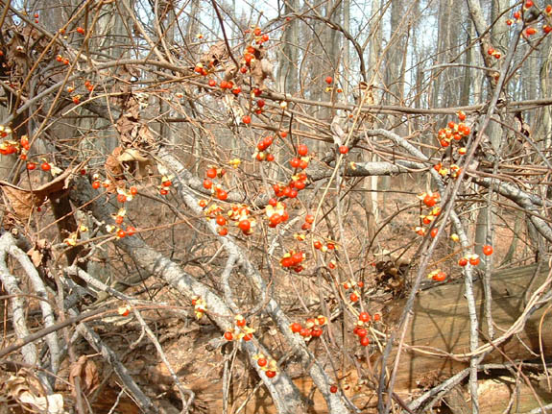
Non-Native Invasive Vegetation
Optional exemption from vegetation standards:
Any wheeled or tracked motorized equipment is operated and stored at least 25ft from the shoreline
  except allowed on existing structural surfaces within 25ft
Any removal within 25ft occurs via hand tools
Replanting required if vegetation standards exceeded
MAINE DEPARTMENT OF ENVIRONMENTAL PROTECTION www.maine.gov/dep

Slide 51
Non-Native Invasive Definition
Invasive species – Do not use
Autumn olive
Black locust
Black swallowwort
Bittersweet, oriental or Asiatic
Buckthorn, smooth & common
Burning bush / winged euonymus
Common reed
European alder
Garlic mustard
Japanese barberry
Japanese knotweed
Japanese stilt grass
Lesser celandine
Mile-a-minute weed
Multi-flora / rambler rose
Nonnative honeysuckles
Norway maple
Porcelainberry
Purple loosestrife
Reed mannagrass
Rosa rugosa
Small-flowered tickle-grass
New definition:
species is invasive and not native to Maine ecosystems
listed by the Maine Department of Agriculture, Conservation and Forestry (Maine Natural Areas Program)
MAINE DEPARTMENT OF ENVIRONMENTAL PROTECTION www.maine.gov/dep

Slide 52
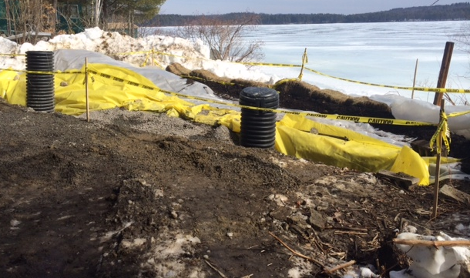
Emergency Response
Exemption from vegetation standards:
Clearing or removal of vegetation associated with emergency response activities conducted by the DEP, the U.S. Environmental Protection Agency, the U.S. Coast Guard, and their agents.
MAINE DEPARTMENT OF ENVIRONMENTAL PROTECTION www.maine.gov/dep
Notes:
Currently allowed by DEP, and rarely required

Slide 53
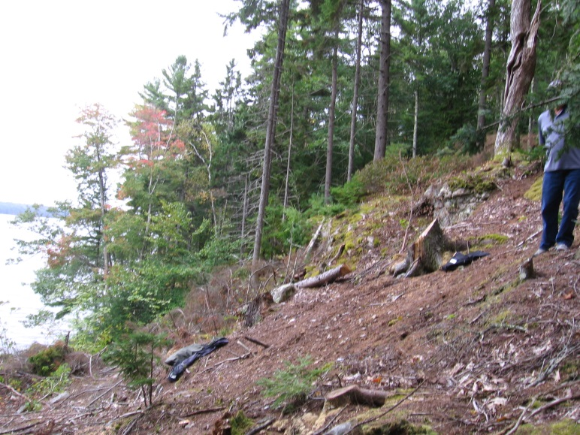
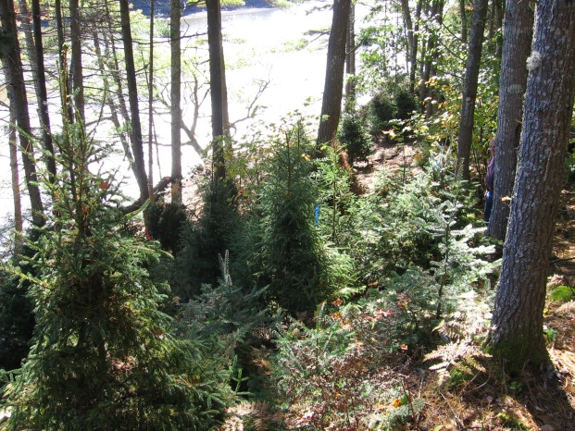
Revegetation Standards
When revegetation is required:
Professional revegetation plan
Specific revegetation location and deadline
MAINE DEPARTMENT OF ENVIRONMENTAL PROTECTION www.maine.gov/dep
Notes:
Prior guidance on revegetation was refined by stakeholders and DEP, into a new section specifying requirements

Slide 54
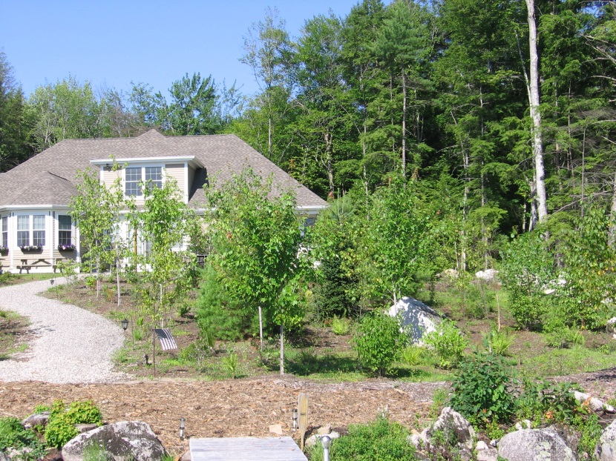
Tree Revegetation
Trees and saplings must be replaced with:
native species
saplings at a minimum
if > 3 planted, then at least 3 different species
no one species shall make up 50% or more
shoreline stabilization: re-establishes screening
survival rate: 80% for 5 years
MAINE DEPARTMENT OF ENVIRONMENTAL PROTECTION www.maine.gov/dep

Slide 55
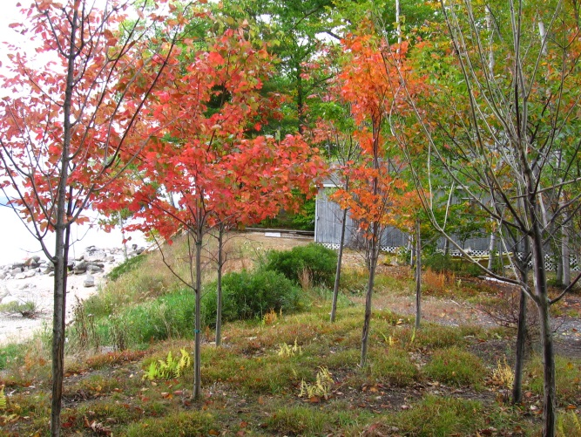
Ground Cover Revegetation
Ground cover must be replaced with:
native herbaceous vegetation
quantities and variety sufficient to prevent erosion and provide for effective infiltration of stormwater
  Where necessary, supplement with mulch 4 inches deep
Survival and functionality must be sufficient to remain in compliance with the vegetation standards for 5 years
MAINE DEPARTMENT OF ENVIRONMENTAL PROTECTION www.maine.gov/dep

Slide 56
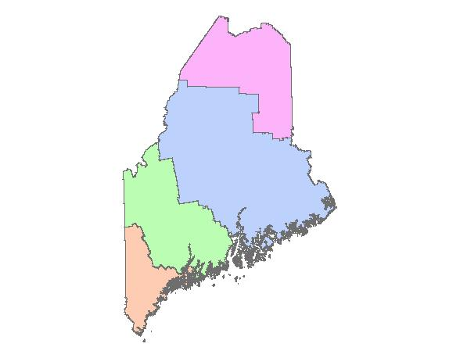
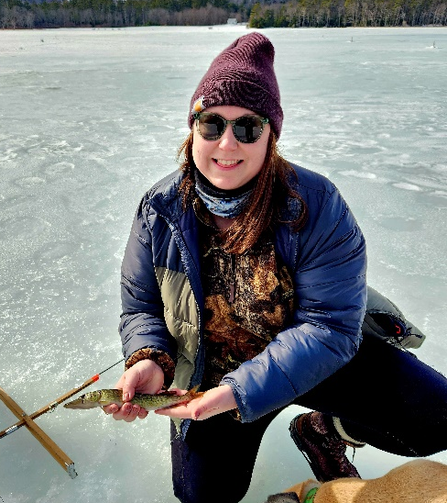
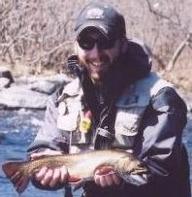
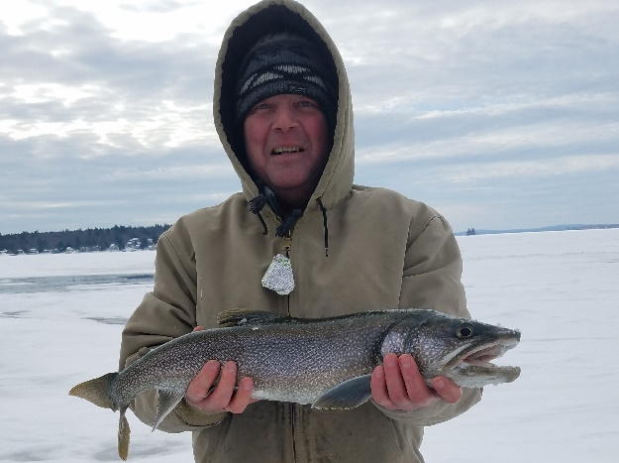
Shoreland Zoning Program
Jessica Sayers
275-9836
Jessica.Sayers
@maine.gov
Colin Clark
441-7419
Colin.A.Clark@Maine.gov
Jeff Kalinich
615-7044
Jeffrey.C.Kalinich@maine.gov
MAINE DEPARTMENT OF ENVIRONMENTAL PROTECTION www.maine.gov/dep
Notes:
Please don’t hesitate to call us when you have questions.

