Slide 1
MaineHousing and Our Programs
Daniel Brennan, Director
February 2, 2024

Slide 2
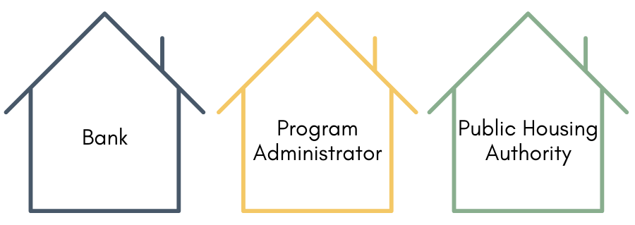
MaineHousing – Who We Are
Independent, quasi-state agency
MaineHousing’s mission is to assist Maine people in obtaining and maintaining quality affordable housing and services suitable to their housing needs

Slide 3
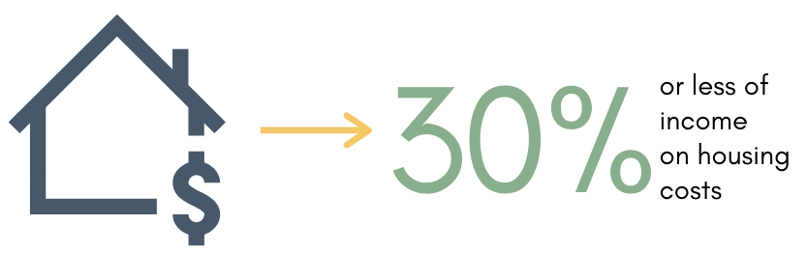
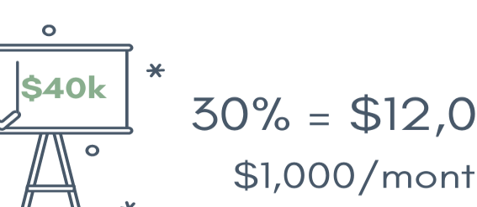
What is “Affordable”?

Slide 4
Tools to Create
Affordable Housing

Slide 5
Multifamily Development
Low-Income Housing Tax Credit
MaineHousing allocates credits
Developer then sells to investors for cash
Cash (equity) = 30% to 70% total development costs
Result = low/no mortgage = lower rents

Slide 6
Non-Tax Credit
Development Programs

Slide 7
Rural Affordable
Rental Housing Program
  For projects 5 to 18 units
  Rents restricted to 80% AMI
  Incomes limited to 80% AMI
  For new construction, acquisition rehabilitation and adaptive re-use
  Affordability covenants for 45 years

Slide 8
Short-Term Real Estate
Acquisition Program
  For public housing authorities, community action agencies and non-profit housing developers
  To provide flexible, short-term capital to quickly purchase real estate; giving MaineHousing partners up to 24 months to close with permanent financing that will fully develop the property into affordable housing
  Short-term rate of 5% (as of December 28, 2022)

Slide 9
Single Family Programs

Slide 10
Affordable Homeownership Program
  For a minimum of 5 homes
  Up to $70,000 per unit in York, Cumberland and Sagadahoc counties (max 20 homes); up to $60,000 per unit in remaining 13 counties (max 23 homes); amounts to be reviewed if more funding received
  Maximum of $1,400,000 per project
  Purchaser incomes governed by MaineHousing’s First Home Loan Program (approximately 120% AMI)
  Maximum home price of $325,000 in York, Cumberland and Sagadahoc counties
  Maximum home price of $287,000 in remaining 13 counties
  Affordability covenants for 15 years

Slide 11
Single Family Programs 1
First Home Loan Program
Advantage (down payment/closing costs)
First Generation Program
Down payment and closing cost assistance
Low fixed interest rates
Financing for mobile homes

Slide 12
Single Family Programs 2
Mobile Home Replacement Program
Community Aging in Place
Delivered by 8 local public housing authorities, 2 community action agencies, 1 Habitat for Humanity
Home Accessibility and Repair Program
Grants for more substantial repairs and emergency life/safety measures
Delivered by Maine’s community action agencies

Slide 13
Subsidized Housing

Slide 14
Housing Choice Voucher
(HCV) Program
Section 8 federal program administered on behalf of HUD
MaineHousing administers approximately 28% of Maine’s housing choice vouchers - remainder are administered by Maine’s 25 local public housing authorities
60% of MaineHousing’s vouchers go to people who are homeless
About 3,800 households currently served

Slide 15
HUD Section 8
Project Based Housing
HUD Section 8 Project Based Housing (1974 – 1983)
  7,806 unit
  226 properties
40 year housing assistance payment contracts tied directly to property
Vast majority of owners renew their contracts – Maine is lucky!

Slide 16
USDA Rural Development Housing
USDA Rural Development Housing
  6,813 units
  290 properties
Many coming up on end of 50 year 1% mortgage
Definite risk of going “market” if not preserved

Slide 17
Supportive Housing
Supportive Housing
  1,822 units
  277 properties
Provides housing to Maine’s most vulnerable citizens (mentally disabled, physically disabled, homeless)
Mostly owned by non-profit service providers
Attempting to encourage more development

Slide 18
Questions?
Contact Information
Daniel Brennan, Director
MaineHousing
26 Edison Drive
Augusta, ME 04330
(207) 626-4611
dbrennan@mainehousing.org

