Slide 1

New-to-ME Planning webinar series
October 6, 2023
Growth Management Law
Judy East, Bureau Director
Resource Information and Land Use Planning
Department of Agriculture, Conservation and Forestry

Slide 2
New-to-ME planning webinar series
Purpose and Goals
Understanding the fundamentals
  statute, rules, and roles of planning in Maine
Introductions and relationship building
Networking
Mentoring
Please use the chat!
Notes:
Understanding for those new to the profession
Fundamentals for those providing TA but with no planning experience
Refresher for those with experience
Getting ready for rulemaking!
It is intended for those new to the profession and those new to planning in Maine. This program responds to a significant increase in new planners in the State. We aim to provide practitioners with an introductory understanding of land use planning legislation and regulations and the governance context in which planners function in Maine.
Growth Management Law, Shoreland Zoning, Home Rule, and the Subdivision Law, to name a few.
Participants will have opportunities to ask questions, connect with colleagues, find mentors, support the next generation of planners, and provide feedback on future training topics and speakers.
Please introduce yourselves in the chat, including your name, your current affiliation/location, and your experience of planning elsewhere and in Maine – its OK to say you are a newby!

Slide 3
GM law – overview for today
GM Law – statutory overview
Timeline – significant dates/changes
Push-pull dynamics - controversy
Need for reform in the 21st Century
Insights from 2023 GM Program Evaluation
Rulemaking – Chapter 208 CP Review Criteria
Notes:
2021 Maine Land Use Law Booklet from the Southern Maine Planning and Development Commission.
put in chat:
https://smpdc.org/index.asp?SEC=BB9B08DF-DC60-4756-A004-E17CAF516509

Slide 4
Maine’s Growth Management Law
Title 30-A Chapter 187 Planning and Land Use Regulation § 4301-4457
Governs preparation/adoption of a local comprehensive plan and associated land use ordinances
Does not require every community to prepare a comprehensive plan - a common misconception
Does require every community that regulates land use to develop a comprehensive plan
To be found consistent with the GM Law, the CP must designate Growth and Rural areas
LD 2003 targets Growth Areas allowing up to 4 units of housing on a lot that allows residential uses

Slide 5
“Growth Management”
Title 30-A Chapter 187 Planning and Land Use Regulation § 4301-4349-A
Definitions § 4301-4302
Growth Management Program
  Statement of Purpose/State Goals § 4312
  Local authority for growth management § 4323 (express limitation on home rule)
  Responsibility § 4324-4325 (public input, regional coordination)
  GM Program elements § 4326
Evaluation §4331 (reporting to legislature)
Technical and Financial Assistance § 4345-4346
Review of Comp Plans §4347 – Rulemaking: Chapter 208
Growth-related Capital Investments § 4349-A
Notes:
Finding the balance between private property rights and community needs/interest to protect health, safety and welfare
§4312. Statement of findings, purpose and goals
General Provisions – Definitions and Statement of Purpose
“set of state goals to provide overall direction and consistency to the planning and regulatory actions of all state and municipal agencies affecting natural resource management, land use and development” to protect health, safety and welfare of the citizens of the State.
Goals – orderly growth and development
Goals summary: Efficient use of public services; accommodate growth and development, promote job opportunities, and economic well being, promote decent housing, protect water, critical natural resources, marine resources, agriculture and forest resources, historic and archeological resources, outdoor recreation resources, plan for Sea Level Rise
§4323. Local authority for growth management
Through the exercise of its home rule authority, subject to the express limitations and requirements of this subchapter, every municipality may: plan for growth, adopt local plans and implementation strategies consistent with procedures, goals and guidelines of chapter….
§4324. Responsibility for growth management - planning committee, public input, hearing, multi-municipal and regional cooperation
§4326. Growth management program elements – inventory and analysis, policy and implementation, guidelines for each; growth and rural designations, capital investment plan, protect water quality, consistency with other state laws, protection of ag/forestry, affordable housing, aging in place, historic preservation, excessive parking, ADUs,
§4331. Evaluation process
The department shall conduct an ongoing evaluation process to determine the effectiveness of state, regional and local efforts under this chapter to achieve the purposes and goals of this chapter. Last done in 2011; supposed to be every 4 years; no staff; will prepare one for 2023
§4346. Technical and financial assistance program
The technical and financial assistance program for municipalities, regional councils and multimunicipal regions is established to encourage and facilitate the adoption and implementation of local, regional and statewide growth management programs (not funded since 2005)
4. Regional council assistance. As part of the technical and financial assistance program, the department may develop and administer a program to develop regional education and training programs, regional policies to address state goals and regional assessments. (funded in early 1990s, significantly reduced in late 1990s, no increase since then while staff and all other costs have increased)
§4347-A. Review of programs by department
1. Comprehensive plans. A municipality or multimunicipal region that chooses to prepare a growth management program and receives a planning grant under this article shall submit its comprehensive plan to the department for review. Rulemaking (procedures, review criteria)
§4349-A. State capital investments
1. Growth-related capital investments. The State may make growth-related capital investments only in: A. A locally designated growth area, as identified in a comprehensive plan adopted pursuant to and consistent with the procedures, goals and guidelines of this subchapter
Exceptions: area served by sewer with capacity; census-designated place; ,urban compact area; commercial-industrial typically located near nat resources, airports, rails, industry dependant on them; pollution control facility; tourist/cultural facility proximate to a park; housing project for individuals with mental illness, other disabilities

Slide 6
“Growth Management”
Title 30-A Chapter 187 Planning and Land Use Regulation
Implementation mechanisms § 4351-4357
Land Use Regulation § 4351-4363
Informed Growth Act § 4365-4372
Subdivision § 4401 - 4408
Enforcement § 4451 – 4453
Municipal Regulation of Water Levels and Minimum Flows § 4454 - 4457
Notes:
3 red items: 1989 limitations on home rule authority
Will speak to informed growth act later – significant dates.
§4351. Home rule limitations
This subchapter provides express limitations on municipal home rule authority. [PL 1989, c. 104,
Pt. C, §45 and Pt (NEW).]
Regulation of manufactured housing § 4358
Zoning ordinances, and relation to Comp Plan (must be consistent and mapped), effect on local governments and state; conditional and contract rezoning; notice requirements; zoning adjustment, appeals, variances; impact fees, moratoria, community living arrangements; regulation of manufactured housing; source water protection; recognition of home rule authority over landfill siting, rate of growth ordinances (growth caps in growth and rural areas); coordination of state and muni dec-mkg in renewable ocean energy projects; small wireless facilities; regulation of tiny homes shall be allowed on SF lots as an ADU
§4365. Short title
This subchapter may be known and cited as "the Informed Growth Act.“ 2007
Large retail or “big box” law; munis can require preparation of a “comprehensive economic impact area”
Subchapter 4 – Subdivisions – definitions, exceptions, municipal review and regulation (application review procedure, hearing requirements, 20 minimum standards); access to direct sunlight;
§4451. Training and certification for code enforcement officers
1. Certification required; exceptions. A municipality may not employ any individual to perform the duties of a code enforcement officer who is not certified; exceptions if undergoing training, Fire Marshalls Office to establish training program; registry of CEOs; non-lapsing training fund; enforcement access, penalties; which rules/regs/licenses to which enforcement applies
§4454. Municipal regulation
Pursuant to the provisions of this subchapter, a municipality may adopt an ordinance under its home rule authority to regulate water level regimes and minimum flow requirements for impounded bodies of water and dams that are entirely within its corporate boundary

Slide 7
GM Law legislative history – significant dates
1989
1991
1999-2001
2003
2007
2008-2011
2019
2022
Enacted
Repealed/reinstated
Growth-related capital investments ++
Growth caps
Informed Growth Act “big box retail”
12-year consistency “shelf life”, rulemaking
ADUs, Ageing in place, downtown parking, Sea Level Rise
Climate, fair housing, Service Centers, goals “clean-up”

Slide 8
Growth Management Law
Push-Pull Dynamics:
Home rule and state oversight
  Complex and controversial
  Originally enacted 1989 after the “consumption decade”
  Very high development pressures (Increasing SDs, BPs)
  Land use is local; most everything else is regional
GM Law (1989)
  REQUIRED municipalities to prepare Comp Plans; address 10 State Goals; designate Growth /Rural areas
GM Law (1991)
  Repealed entirely; reinstated given the constitutional need to base zoning on public policy as expressed in a Comprehensive Plan; CPs no longer mandatory
Notes:
Indication of how long memory is – when it is grounded in something that irritates people, and even when it is inaccurate

Slide 9
GM Law – anti-sprawl and rate of growth initiatives
GM Law (1999-2001): Several measures to give local Comp Plans more “teeth” and address costs of development sprawl
  Growth-related capital investments targeted to growth areas § 4349-A
  Required inclusion of Capital Investment Plan
  Required Timetables for implementation
GM Law (2003): Rate of Growth Ordinances § 4360 “Growth caps”
  Sets limits on # of permits in growth and rural areas
  Affordable housing provision
GM Law (2007): Informed Growth Act § 4365-4372 “big box retail”
  Municipalities can require a “comprehensive economic impact area” study when large retail is proposed
Notes:
§4349-A. State capital investments
1. Growth-related capital investments. The State may make growth-related capital investments only in: A. A locally designated growth area, as identified in a comprehensive plan adopted pursuant to and consistent with the procedures, goals and guidelines of this subchapter
Exceptions: area served by sewer with capacity; census-designated place; ,urban compact area; commercial-industrial typically located near nat resources, airports, rails, industry dependant on them; pollution control facility; tourist/cultural facility proximate to a park; housing project for individuals with mental illness, other disabilities
2001 zoning, rate of growth, impact fee ordinances tied to CPs

Slide 10
GM Law – Rulemaking
Rulemaking and then a significant political pendulum shift
GM Law (2008-2011): substantial rulemaking intended to streamline CP review process
  Focus on future land use plan
  Checklist for review of Comp Plans
  12-year “shelf life” for consistency findings
  Significant loss of state staff and state/regional/municipal resources
  Erosion of state agency implementation of growth-related capital investments
GM Law (2012): elimination of State Planning Office
  Shift of land use staff to Municipal Planning Assistance Program at DACF
Notes:
Dissolution of SPO – shift of land use team to DACF in Municipal Planning Assistance Program
significant loss of staff; 12 in early 1990s; 8 in early 2000s, 4 in 2011; 2 in 2016
inability to provide technical assistance;
No funding for municipalities (ended 2007); reduced funding for regional planning councils
Erosion of other state agencies adhering to 4349-A (Growth-related capital investments)
4349-A. 2-A. State's role in implementation of growth management programs. All state agencies, as partners in local and regional growth management efforts, shall contribute to the successful implementation of comprehensive plans and growth management programs adopted under this subchapter by making investments, delivering programs and awarding grants in a manner that reinforces the policies and strategies within the plans or programs. Assistance must be provided within the confines of agency policies, available resources and considerations related to overriding state interest.
[PL 2001, c. 406, §14 (NEW).]
3. Preference for other state grants and investments.
[PL 2003, c. 604, §1 (RP); PL 2003, c. 604, §3 (AFF); PL 2005, c. 397, Pt. A, §32 (RP); PL
2005, c. 397, Pt. A, §33 (AFF).]
3-A. Preference for other state grants and investments. Preference for other state grants and
investments is governed by this subsection.

Slide 11
GM Law –recent changes
GM Law (2019): downtowns, aging in place, sea level rise
  Accessory dwelling units
  Downtown parking; upper floor re-use
  Housing to age in place; create age-friendly communities
  Plan for the effects of sea level rise on infrastructure
GM Law (2022): various
  Fair housing provision linked to economic equity in goals
  LD 2003 provisions in affordable housing and increased density in growth areas
  Implement Maine Wont’ Wait – 4 Year Plan for Climate Action
  Service Center Analysis – every 5 vs. every 10 years
  Goals and guidance ”clean-up”
Notes:
.

Slide 12
Created in 1989 - pre-Internet
21st Century need & speed of change
Preparation:
  Inventory requirements
  Staff demand on assembly of data; municipal/staff/contractor/volunteer demand to send it back
  Opportunity cost: public involvement, policy, and strategy development
  Volunteer burnout
State Review Process:
  Checklist/inventory vs. policy focus
  Timeliness and state capacity
  Static data and maps as a decade+ elapses

Slide 13
Evaluation §4331 - report to legislature
§4331 - The department shall conduct an ongoing evaluation process to determine the effectiveness of state, regional and local efforts under this chapter to achieve the purposes and goals of this chapter. The department shall seek the assistance of other state agencies. If requested, all state agencies shall render assistance to the department in this effort.
1. Criteria. In conducting the evaluation, the department shall develop criteria based on the goals of this chapter. The criteria must be objective, verifiable and, to the extent practicable, quantifiable.
2. Baseline conditions. The department shall establish a baseline of land use conditions at a level of detail sufficient to permit general comparison of state and regional trends in future land use development patterns.
3. Public input. The department shall incorporate opportunities for public input and comment into the evaluation process.
4. Level of analysis. The department shall evaluate the program generally at a regional and statewide level. To illustrate the impact of the program, the department shall compare land use development trends and patterns in a sample of towns that have participated in the program with a matched sample of towns that have not participated. The evaluation performed by the department must include an analysis of the State's financial commitment to growth management.

Slide 14
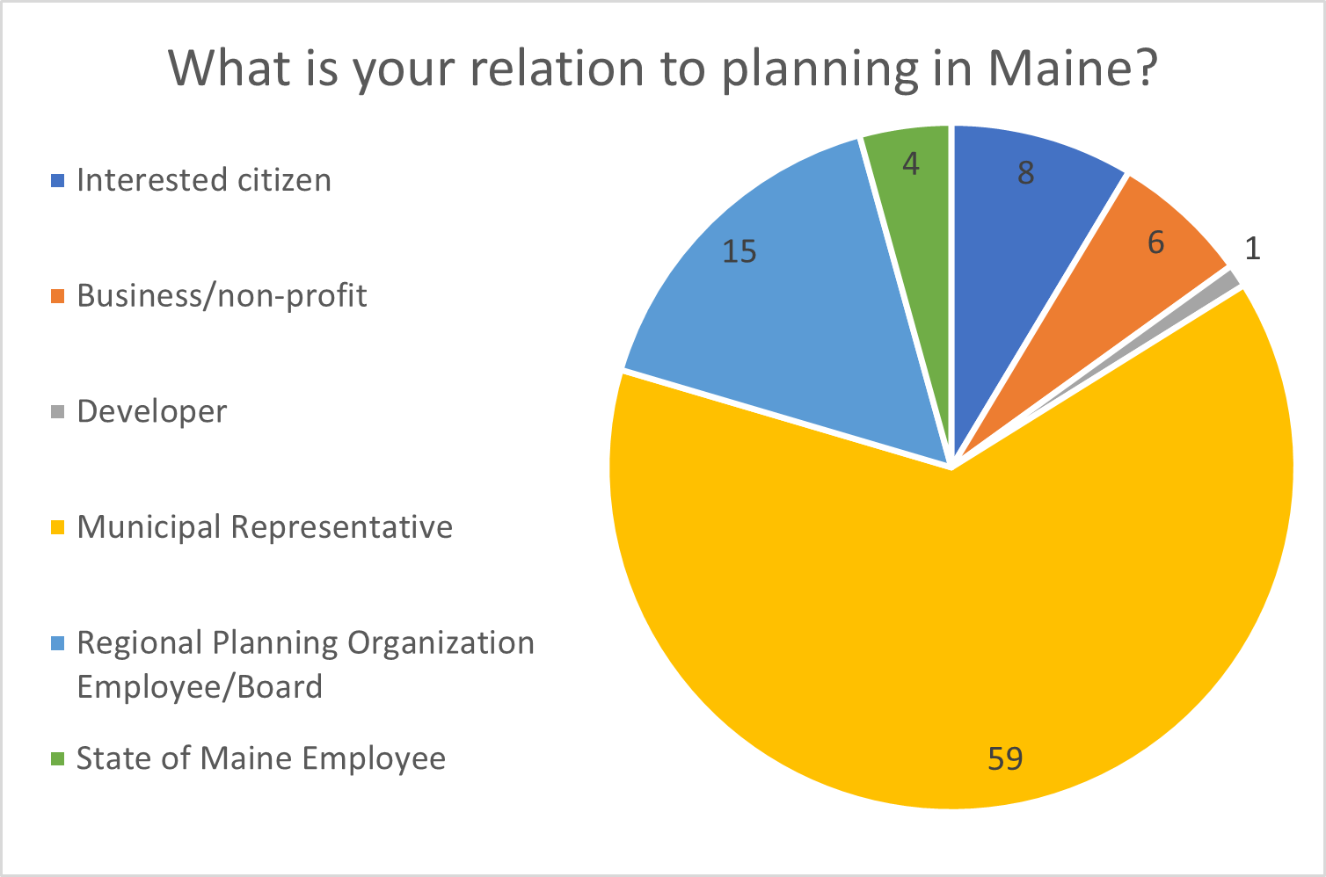
GM Law Evaluation – January 2023
  Three criteria for evaluation:
  Development tracking
  Local and regional planning activity
  State financial commitment to the growth management program
  Each criterion:
    Status & analysis
    Findings & Recommendations
  Broad consultation
Notes:
Put link in chat
https://www.maine.gov/dacf/municipalplanning/docs/growthmanagementevaluation2023.pdf
Staff at MPAP would like to thank the many organizations and networks for their assistance in circulating the survey and those who took the time to provide their input. Responses were constructive, insightful, and detailed and will improve the operation of the law and its future implementation.
Appendix A reproduces the many insightful comments from the interested parties on suggested changes to the Growth Management Program and the Law itself and recommendations to further improve Maine’s Comprehensive Plan Review Criteria Rule (Chapter 208). T

Slide 15
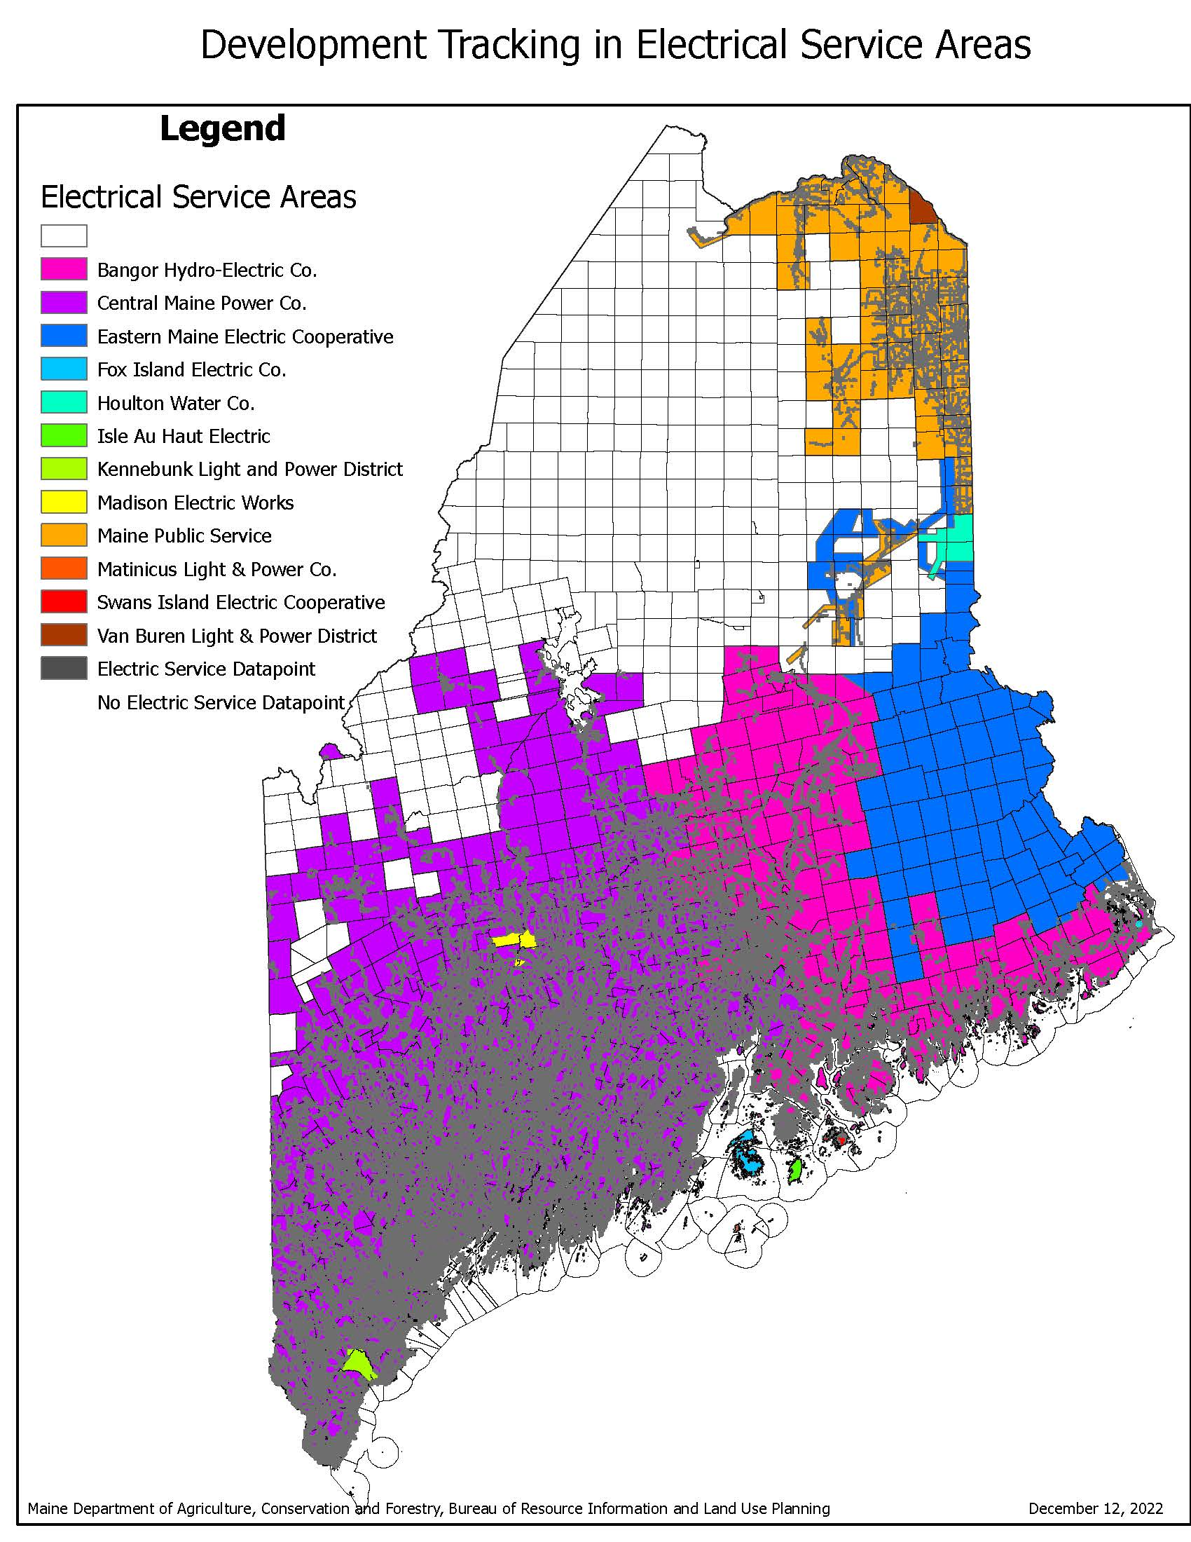
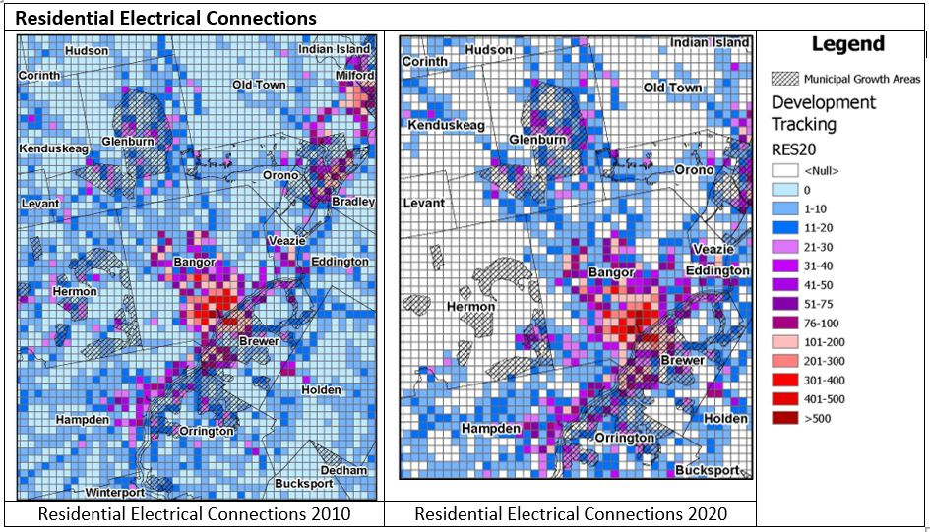
Development tracking
Change detection of impervious surfaces and building locations
New electrical service connections
E-911 address points (survey suggestion)
Notes:
A statewide dataset of building permits would be ideal for tracking development over time. Larger cities like Auburn commented that they could do this within their boundaries. In addition to having the capacity to geographically track building permits, larger cities have digital parcel maps and GIS staff who can manipulate them. A statewide data set of building permits is infeasible at this time, given the lack of data and staff to assemble what is available.
Similarly, not all communities have digital parcel maps, most do not have the GIS capacity to manipulate them, and there is no statewide parcel coverage that integrates the digital parcel data when it does exist. Furthermore, this parcel data is not maintained in any comprehensive way as parcels are changed and divided.
These geospatial data gaps highlight an important point. It is not feasible nor necessary for all data assembly to take place at the state level. Regional building permit tracking in high-growth counties may be possible with cooperation and additional funding at the regional level. GIS mapping for many small municipalities is also most efficiently provided by Regional Planning Organizations. The patchwork and variability of parcel mapping accuracy and data issues (contiguity, maintenance, and updates) is a significant issue that goes beyond the scope of this analysis. Addressing it would contribute significantly to the success of tracking development on a regional and statewide basis.To fulfill the mandate to report and evaluate the Growth Management Program to the legislature, MPAP needs additional GIS staff and mapping capacity to:
reach out to all electric utilities to complete statewide coverage of electrical service connections;
• assemble a statewide coverage of locally designated growth areas;
• collect and organize data to support the assessment of land use change;
• provide technical assistance to regional and municipal users to interpret the data;
• develop online map viewers to allow non-GIS users to access development trend data; and
• research national and regional datasets to assess the extent and integrity/applicability of structures, land cover, and impervious surfaces to track development in Maine.
Happy to announce introduce new Sr Planner Abe Dailey and Planner Ashley Gamache who will use thir skills to address these recommendations

Slide 16
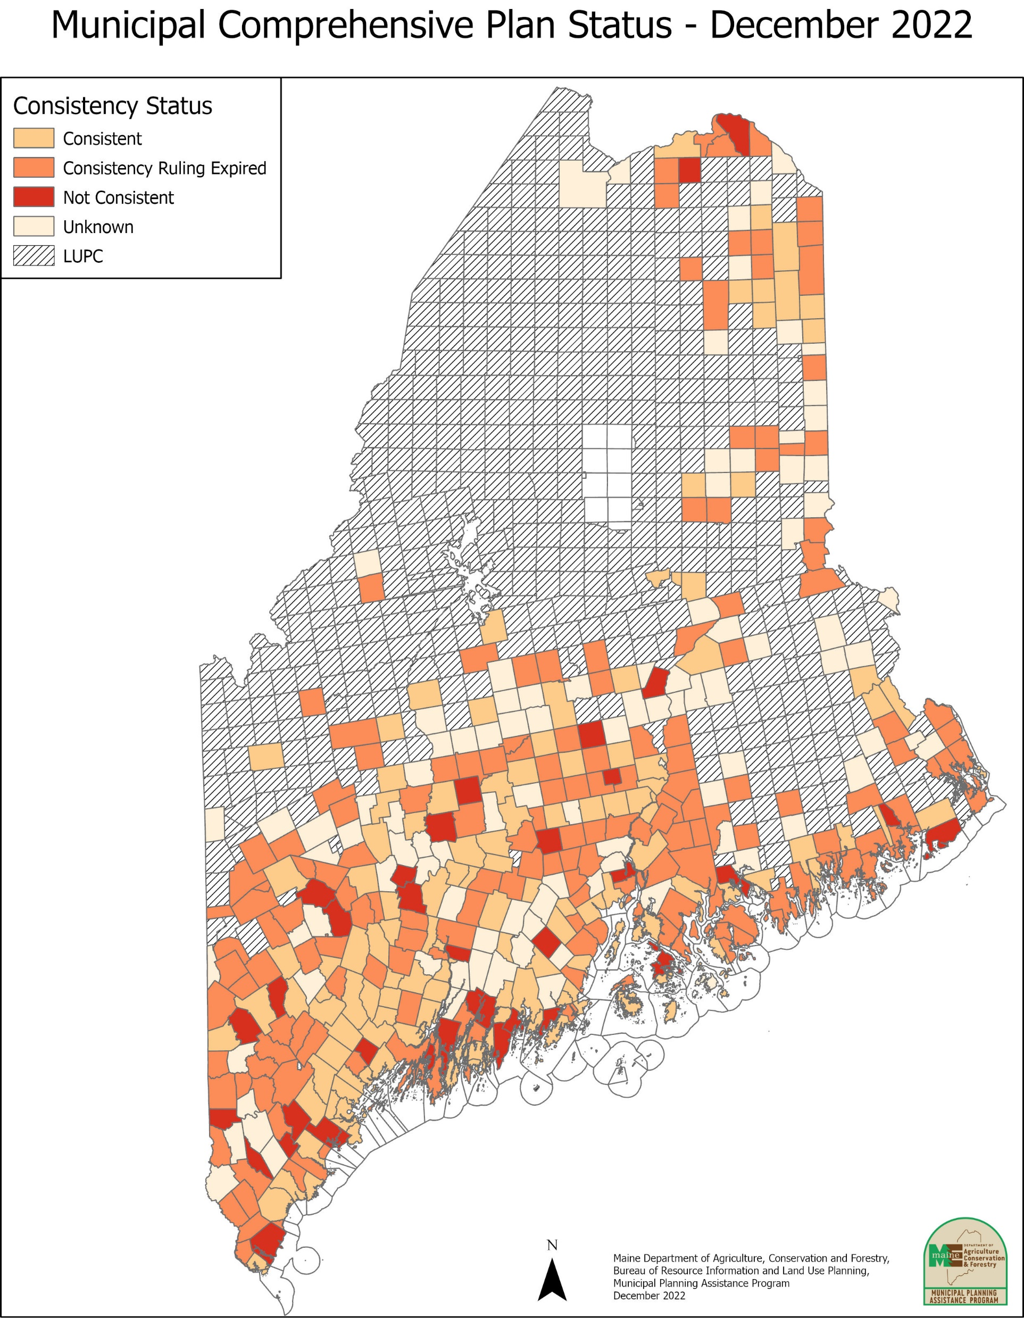
Local & regional planning activity
Since 2011
149 Comprehensive Plans submitted for state review
  132 found consistent
  7 under review (early 2023)
  3 incomplete – 2 were corrected and found consistent
  1 inconsistent (resubmitted and under review)
  1 withdrawn
Current status:
  132 consistent with GMLaw
  183 – expired consistency finding
  37 found inconsistent
  102 are unknown (never prepared or never submitted)
Last 3 years:
  123 communities received data sets (58 with expired consistency finding)
Notes:
The cost savings to municipalities - anticipated in the 2011 Growth Management Law evaluation, with adoption of Chapter 208 in 2007, may not have been achieved.
Municipalities continue to write and update comprehensive plans, often without municipal planning staff to guide the process and write the plan. Smaller, rural municipalities without staff capacity lack the financial resources to hire consultants and must rely on local volunteers. Without professional help, the plan preparation process can take two or more years. In addition, the inventory requirements are extensive. Current data and a clear analysis of local and regional issues is critical to support land use decisionmaking. However, the statute and criteria rule rely on state agencies to generate data packages that the municipalities turn around and send back in a document that does not reflect the availability of realtime digital information and online mapping tools.
The result can be: a) an overfocus on inventory at the expense of local energy devoted to policy and implementation, b) resulting “volunteer burnout,” c) a large and perhaps misdirected burden on state agencies, and d) analysis that is “frozen in time” while changes in the community, in technology, the economy, the climate, and other factors are accelerating.
Findings and Recommendations
Determine ways to reduce the inventory burden overall and particularly on small rural municipalities;
Strengthen requirements to implement regulatory mechanisms such as zoning to address rural sprawl;
Develop and publish guidance at the state level to assist municipalities in identifying growth areas and developing regulatory standards that guide and incentivize infill development and additional growth in growth areas; Increase funding to municipalities and Regional Planning Organizations as already allowed for in MRS 30-A § 4346, Technical and Financial Assistance Program; and •
Strengthen the enforcement across state government in the awarding of grant funding to municipalities that prepare and adopt Comprehensive Plans consistent with the law (MRS 30-A § 4346 Section 5).

Slide 17
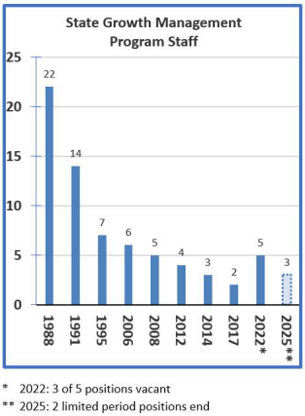
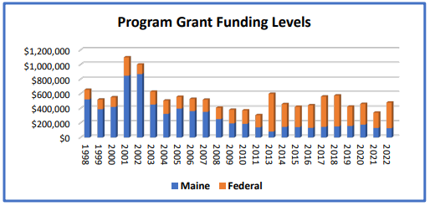
State financial commitment to the growth management program
Four main conduits for state investment:
a land use program at MPAP (former State Planning Office)
municipal grants to develop and implement comprehensive plans (eliminated in 2007)
grants to Regional Planning Organizations
state investment in local facilities and infrastructure
Notes:
four main conduits for state investment: 1) a land use program at MPAP (formerly the State Planning Office), 2) municipal grants to develop and implement comprehensive plans (eliminated in 2007); 3) grants to Regional Planning Organizations; and 4) state investment in local facilities and I
Financial support is most effectively and efficiently provided at the state level for:
Improved delivery of data and GIS services;
Strong technical assistance materials and models for focusing growth and implementing planning strategies; and •
Train the trainer program delivery
And at the regional level for:
Training of municipal officials;
Base level funding to help small rural municipalities with:
identifying, scoping, preparing, securing, and administering grant funding;
GIS mapping services;
technical assistance on issues other than climate and housing, such as moratoriums, capital investment planning, ordinance examples, targeting growth, and protecting rural resources from development sprawl.
Prepare regional plans that reduce the need to prepare Comprehensive Plan sections for multiple small rural municipalities.
The municipal level for:
Grant funding for Comprehensive Planning and implementation efforts

Slide 18
Chapter 208 – Comprehensive Plan
Review Criteria Rule
Rulemaking initiated July 2023
8-9 month process
Drafting within MPAP/BRILUP
Outreach meetings to review concepts/drafts in January-March
Goals:
  Address one size fits all issue – allow/encourage a significant increase in regional plan preparation to address regional issues (73% of ME municipalities: population less than 3000)
  Larger communities can still address/include the full range of topic areas
Data delivery improvements
  Online GIS access (new MPAP staff)
  Development tracking
Rules, Statute, Guidance
Notes:
regional issues in most towns and particularly in small rural communities:
Population shifts
Economic development, workforce movement
Habitat and open space conservation
Agriculture and Forestry activities
Housing
Recreation
Transportation
Waste Management
Emergency Management/law enforcement
Health care and education
History even!
Strictly local issues:
Land Use
Local facilities and services
Fiscal capacity

Slide 19
Questions?
Additional research?
Judy East, Bureau Director
Resource Information and Land Use Planning
Department of Agriculture, Conservation and Forestry
Judith.c.east@maine.gov

